Slide 1
Mobilização de dados atravès do GBIF – usos na pesquisa
Tim Hirsch, Deputy Director, GBIF Secretariat
SiB-Br Relaunch event, Brasilia, 25 November 2014

Slide 2
Usos de dados na pesquisa
Espécies exóticas invasoras
Impactos das mudanças climáticas
Prioridades na conservação (espécies ameaçadas, áreas protegidas)
Agricultura e alimentação (parentes silvestres de lavouras)
Saúde humana (doenças zoonóticas)
Entendimento de biodiversidade (biogeografia, filogenética, ecologia)
GBIF Science Review available at http://www.gbif.org/resources/3427.

Slide 3
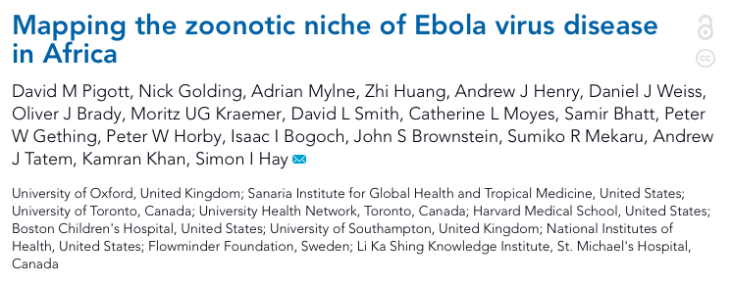
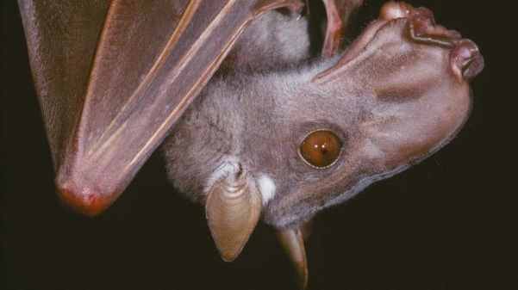
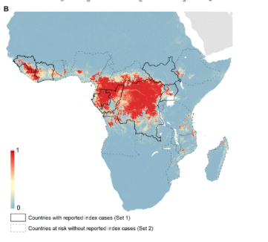
Uso de dados: saÚde humana
Modelled environmental niches of 3 bat species associated with Ebola transmission
Occurrence records accessed via GBIF
At-risk areas cover 22 countries, population of 22 million
Helps to prioritize surveillance and diagnositic capacity in at-risk areas
Pigott, David M., et al. "Mapping the zoonotic niche of Ebola virus disease in Africa." eLife 3 (2014): e04395. DOI: 10.7554/eLife.04395

Slide 4
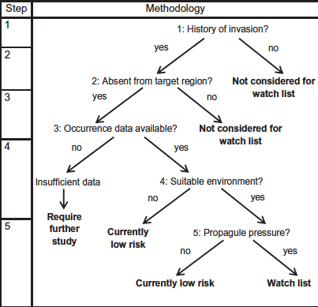
Uso de dados: espÉcies invasoras
Used more than 20m records via GBIF of 884 species on Global Invasive Species Database (GISD)
Modelled likely invasion success for South Africa based on environmental suitability, propagule pressure
Identified watch list of 400 potential invaders
Methodology applicable to any region
http://dx.doi.org/10.1016/j.biocon.2014.08.014

Slide 5
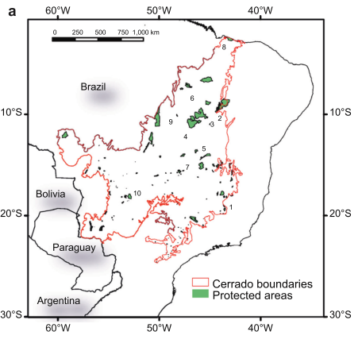
Uso de dados: prioridades na conservação
Obtained occurrence records of 30 endemic Cerrado lizards from GBIF and other sources
Produced distribution models using Maxent
Formulated conservation targets based on natural rarity, vulnerability (future habitat loss), life history
Gap analysis considering strictly protected areas
Found only one species was adequately protected by existing network
http://dx.doi.org/10.1016/j.biocon.2014.09.016

