Slide 1
Mobilização de dados atravès do GBIF – a infraestrutura global
Tim Hirsch, Deputy Director, GBIF Secretariat
SiB-Br Relaunch event, Brasilia, 25 November 2014

Slide 2
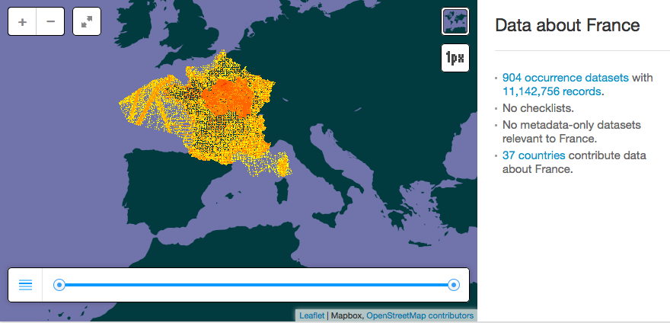
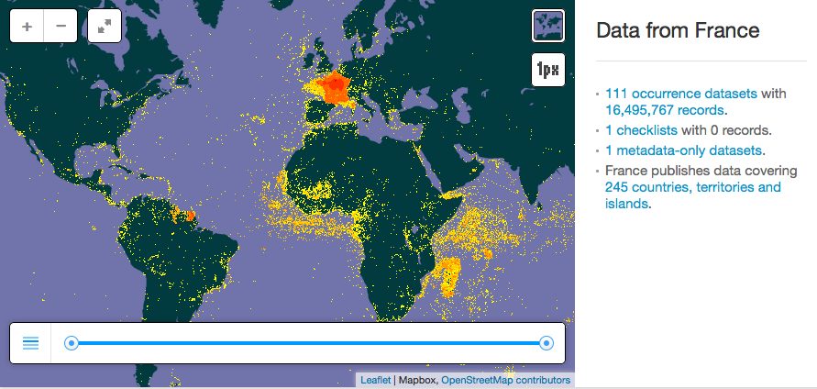
´repatriação´ de dados
Devolução de dados para os paises de origem atraves do acesso eletrônico
http://www.gbif.org/country/FR/summary
Notes:
The principle of ‘data repatriation’ is demonstrated in these two slides showing data currently displayed on the ‘country page’ for France in GBIF.org. (http://www.gbif.org/country/fr). The first map shows all data for species observed or collected in France and its coastal waters. This amounts to around 11 million records, from over 900 datasets shared from institutions in 38 countries. (animate) The second map shows all data shared by institutions in France. You’ll see that although these are strongly concentrate in French territory, they actually span the world, sharing data on biodiversity located in 245 countries, territories and islands – thus making this data available to governments and researchers in the countries where these species originate.

Slide 3
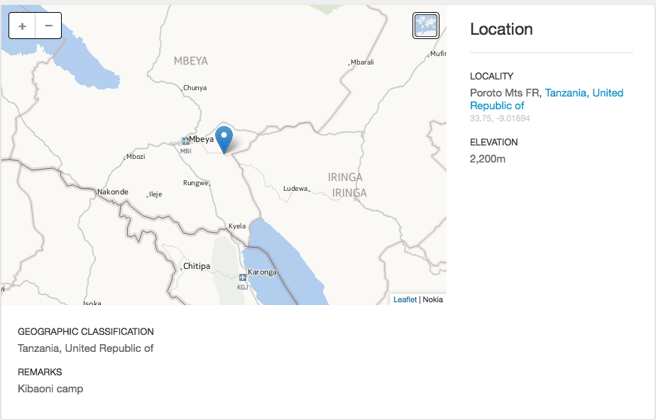
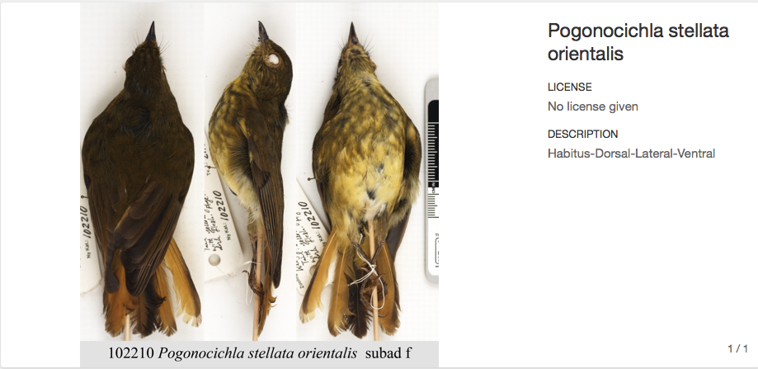
Acesso aos recordes detalhados
Notes:
A recent development in GBIF has been to enable users to access much richer information about each species occurrence record, through harvesting a wider set of fields included in the records submitted by the data publishers. In addition to the core information of species, location and date of collection, this includes details such as field notes and remarks, the life stage of the individual and now (a new feature launched in June 2014) any images, audio or video associated with the record. In this example, a specimen from the Tanzanian bird collection at Denmark’s Natural History Museum is shown complete with the location and date of collection, the name of collector and the image of the actual specimen.

Slide 4
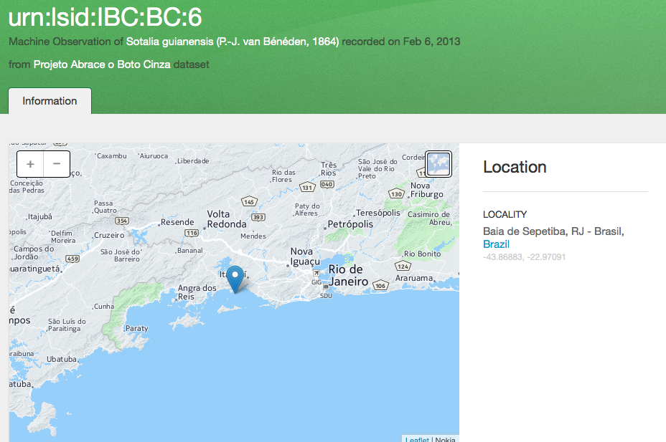
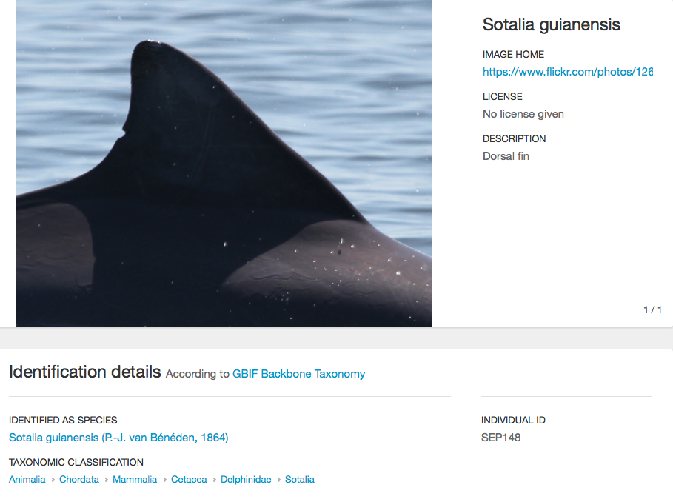
Acesso aos recordes detalhados
Notes:
A recent development in GBIF has been to enable users to access much richer information about each species occurrence record, through harvesting a wider set of fields included in the records submitted by the data publishers. In addition to the core information of species, location and date of collection, this includes details such as field notes and remarks, the life stage of the individual and now (a new feature launched in June 2014) any images, audio or video associated with the record. In this example, a specimen from the Tanzanian bird collection at Denmark’s Natural History Museum is shown complete with the location and date of collection, the name of collector and the image of the actual specimen.

Slide 5
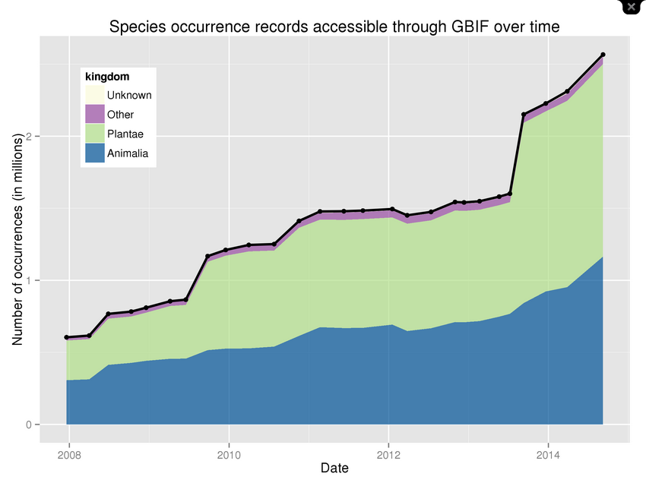
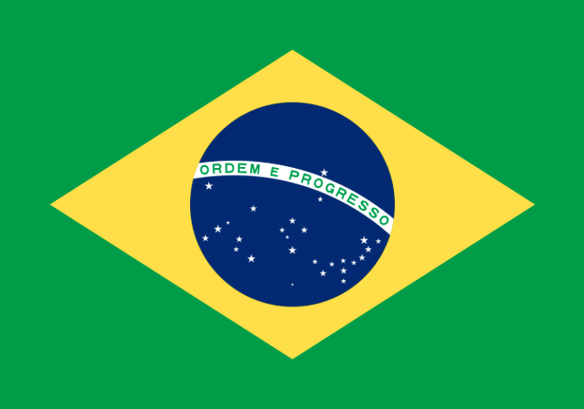
AnalÍticos de dados por pais
http://www.gbif.org/analytics/country/BR/about

Slide 6
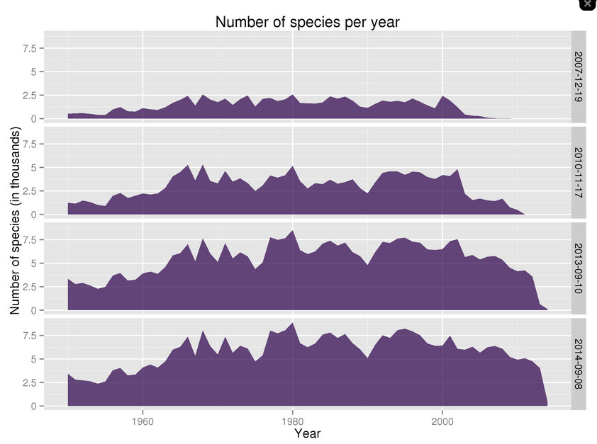
AnalÍticos de dados por pais
http://www.gbif.org/analytics/country/BR/about

Slide 7
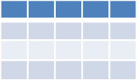
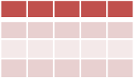
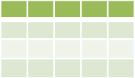
GBIF e ´Digital Object Identifiers´ (DOI)
GBIF.org
DataCite Denmark
GBIF registers datasets
without existing DOIs
with DataCite Denmark
IPT
Any tool
Any tool
National DataCite Service
Publisher uses IPT to register dataset with DataCite
Publisher establishes DOI externally
Publisher does not provide DOI
Data Publishers

Slide 8
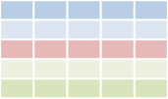
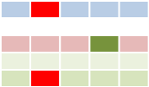
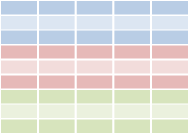
GBIF E ´Digital Object Identifiers´(DOI)
GBIF download
Cleaned data
Paper
Download DOI
Dataset DOI
Paper DOI
Data
Data
User publishes paper
Published paper can give resolvable links to GBIF download and/or to cleaned dataset
User cleans data
Researcher
Data attribution
Data attribution
User searches for data through GBIF.org
User deposits cleaned dataset in a repository and gets DOI for dataset
GBIF.org
Download history
Download 1
DataCite Denmark
. . .
GBIF assigns DOIs to
data downloads
GBIF.org creates a download data set

Slide 9
Usos de dados na pesquisa
GBIF Science Review available at http://www.gbif.org/resources/3427.

