Slide 1
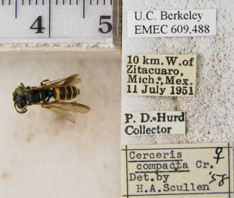
Task Cluster 4 - Electronic Data Capture: collection data management and data capture
Presenter: Deborah Paul
Florida State University
Integrated Digitized Biocollections (iDigBio)
Brazilian Biodiversity Information System (SiBBr) Launching Event
25 November 2014
Brasilia, DF, Brazil
Notes:
Deb: Data capture / transcription (Deb) – 10 minutes (high-level)
Staffing (volunteers, paid staff, the public)
key-boarding (data entry), short-cut key-strokes
voice software / multi-keying / ocr / crowd / volunteer
database software and data-entry issues (ditto, drop-downs, scripts for validation)
error catching / data validation strategies
Andrea on Specific Tools for Data Capture, including Public Participation
OCR output and parsing of labels, Matsunaga
focus on specific tools
Greg: Public Participation, Riccardi
about BIOSPEX

Slide 2
Data Capture
Image Capture
Georeferencing
and
Enrichment
Image Processing
Pre-digitization Curation or
Staging
Data Capture
Personnel
Image / Data Storage
Written
Workflows
Biodiversity Informatics Manager
Notes:
Slide 2 the task clusters (with personnel and written protocols and continuous eval, biodiv informatics folks)

Slide 3
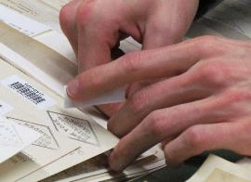
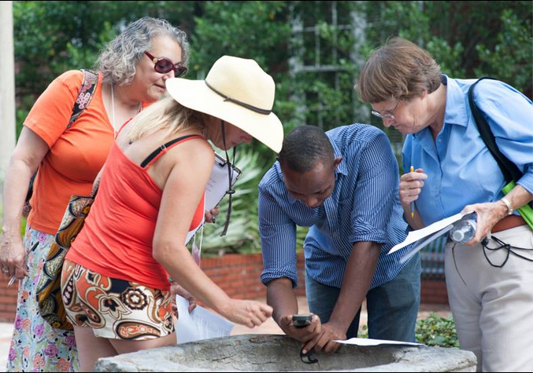
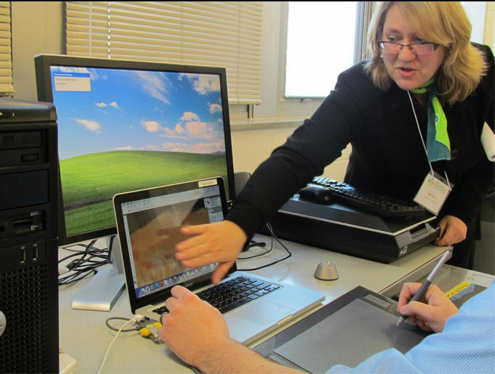
Staffing
Data Entry, Imaging, Data Validation
Considerations
In-house volunteers
Paid staff
Citizen scientists
Training
Roles
Autonomy
Managing Staff and Data

Slide 4
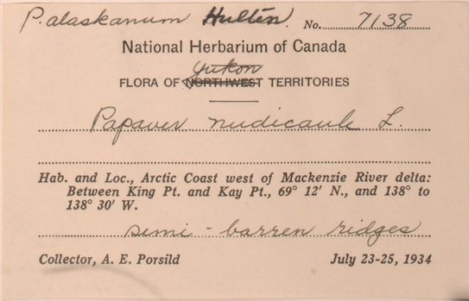
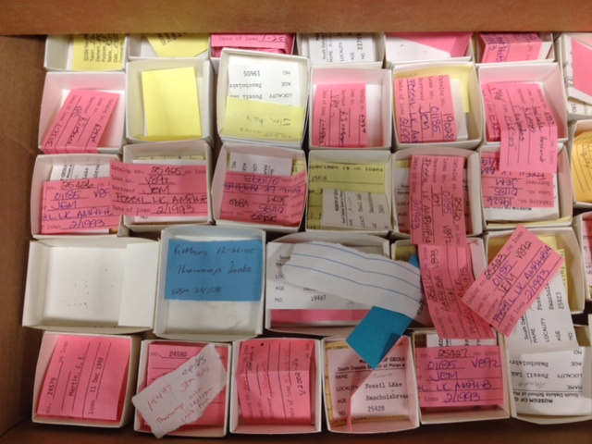
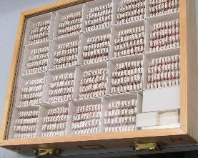
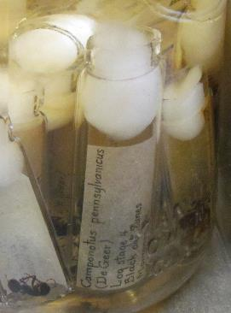
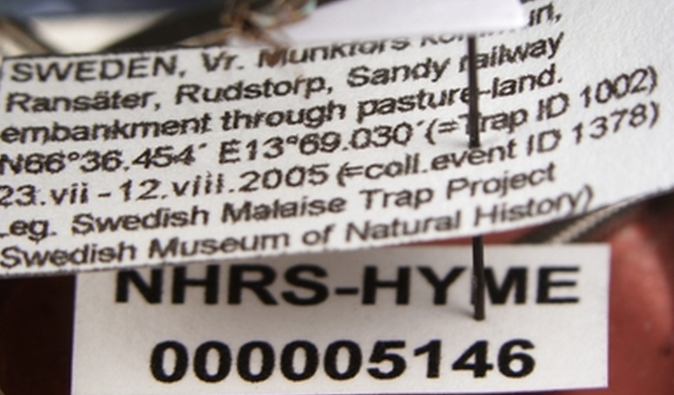
Labels Notebooks Card Files Vials, …
Notes:
From specimen?
From image of the specimen label?
From image and Optical Character Recognition output?
Voice too?
Touch screen?

Slide 5
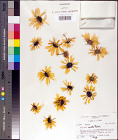
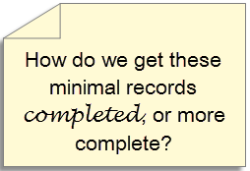
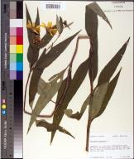
Minimal Data Capture
Trend
“filed as” name
higher geography
barcode
image
all sheets in folder get the same initial data
only the barcode differs
filed as name
Biological collection data capture: a rapid approach using curatorial data
Notes:
Biological collection data capture: a rapid approach using curatorial data
Read this to get an idea of the current trend in digitizing minimal records to start.
http://www.rbge.org.uk/assets/files/science/Herbarium/digitisation/Biological%20collection%20data%20capture%20poster.pdf

Slide 6
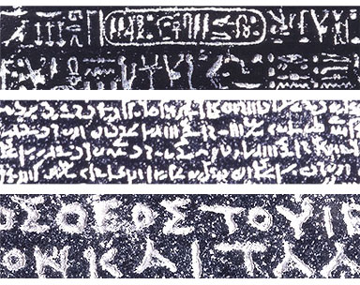
Note darwin core / georeferencing standards
Your database
My database
map to a standard!
http://www.britishmuseum.org/images/rosettawriting384.jpg
Notes:
http://prezi.com/iib3pqk-kyd-/curators-workbench/
Why care about standards? What do they have the potential to accomplish?
Collection Managers are doing what they need to do – for themselves, their collections.
When we share, we need standards.
Data becomes useful for others / other purposes.
a common vocab is required
Feedback and Attribution become possible.
The collection gets used, more, increasing the value of the collection.
indirect, subtle
Putting identifiers on specimens --- makes more useful to others.
consistency is important!

Slide 7
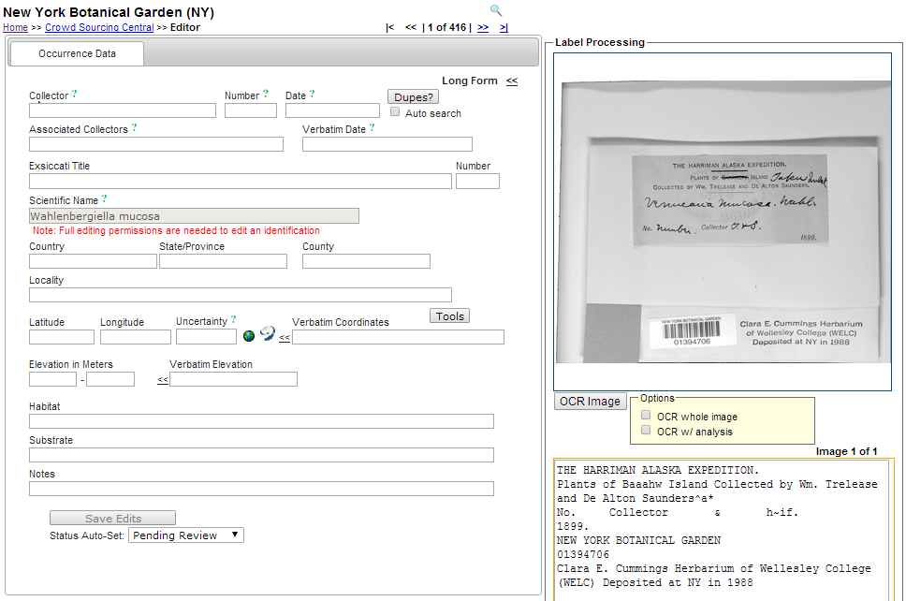
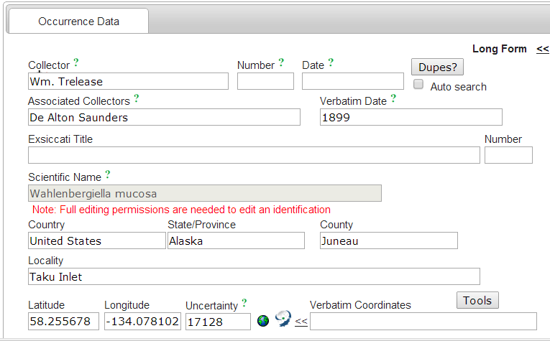
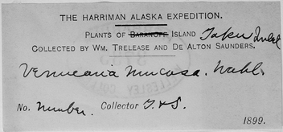
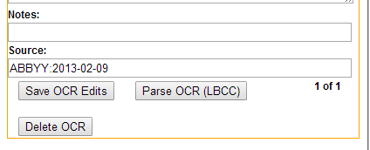

Slide 8
Specimen Data Capture
Extracting label data
Before, during, after imaging (a choice)
Entering data from label images
reduces specimen handling
can facilitate ability to read labels
creates a voucher for the label
Database interface often customized
speeds data transcription and enhances accuracy
Data often imported from spreadsheets (Specify)
Online data entry (in-the-cloud)

Slide 9
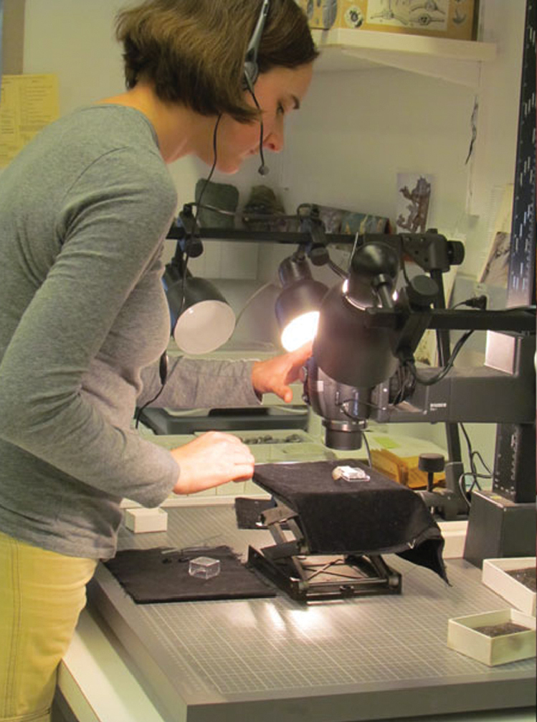
Data Capture Options
Data capture with voice* (shhhhhh)
Using OCR software and OCR output parsed into database
vetted by a person
OCR output is searchable!
Records multi-keyed
Crowd-sourcing

Slide 10
A few more key thoughts about data capture …
database software and data-entry issues
ditto,
drop-downs,
automated scripts for validation
error catching / data validation strategies
tracking what has / has not been entered / imaged
protocols / workflows continuously evaluated
data quality / integrity

Slide 11
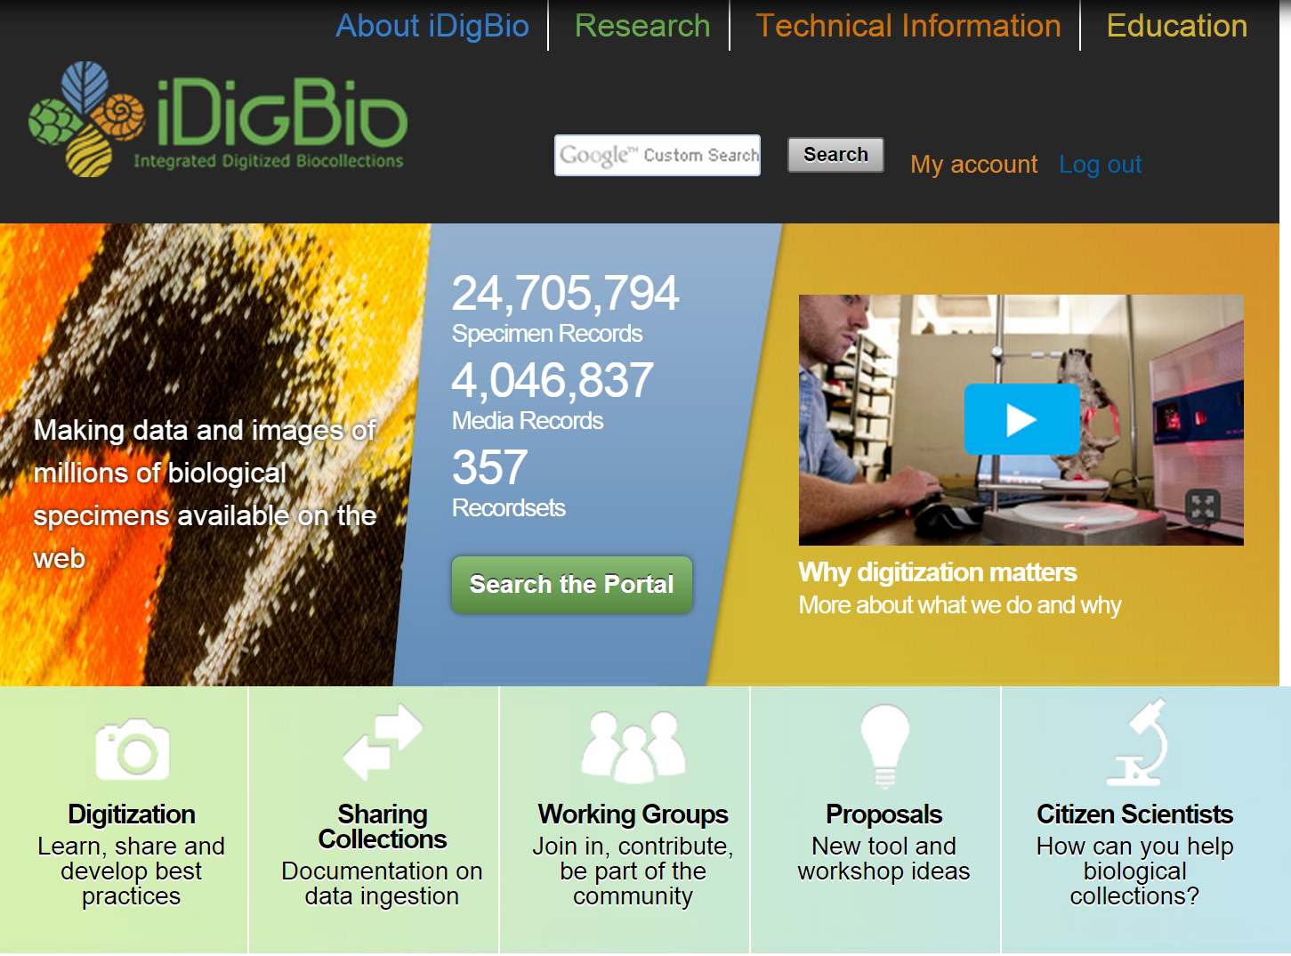
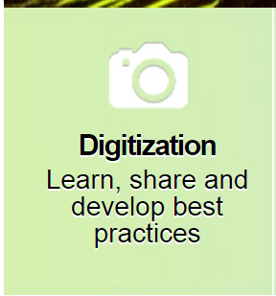

Slide 12
Obrigada SiBBr! Find out more at … https://www.idigbio.org/content/workflow-modules-and-task-lists

Slide 13
Label
OCR
No. ....2L31.
National Herbarium of Canada
FLORA OF’T TERRITORIES
.
Hab. and Loc., Arctic Coast west of Mackenzie River delta:
Between King Pt. and Kay Pt., 69° 12’ N., and 138° to
138° 30’ W.
. .
Collector, A. E. Porsild July 23-25, 1934
Next imagine output from 1000s of labels or notebooks or text files!

