Slide 1
Task Cluster 1 - Pre-digitization curation and staging: decisions / opportunities / options
Getting Started!
Presenter: Deborah Paul, @idbdeb
Florida State University
Integrated Digitized Biocollections (iDigBio)
Brazilian Biodiversity Information System (SiBBr) Launching Event
25 November 2014
Brasilia, DF, Brazil
#SiBBr
Notes:
Task Cluster 1: Pre-digitization curation and staging
what are you going to digitize? (all, part)
curatorial tasks that have to be done
examples: organizing specimens for images, straightening out taxonomy, ...) applying identifiers
what database, what other software (OCR?)?
preparing the database
taxonomic trees / tables
getting all localities done beforehand (ent example)
what kind identifiers?
how will data be shared / exported / re-integrated
who is going to enter the data?
Staff
Volunteers
ocr & public participation (crowdsourcing, citizen science)
workflow documentation and strategies
protocol development
institutional policy
where to find this information after this talk

Slide 2
Pre-Digitization Curation
Image Capture
Georeferencing
and
Enrichment
Image Processing
Pre-digitization Curation &
Staging
Data Capture
and
Processing
Personnel
Image / Data Storage
Written
Workflows
Protocols
Policy
Biodiversity Informatics Manager
Notes:
Slide 2 the task clusters (with personnel and written protocols and continuous eval, biodiv informatics folks)
The entire workflow process
Data Quality
Data Integrity

Slide 3
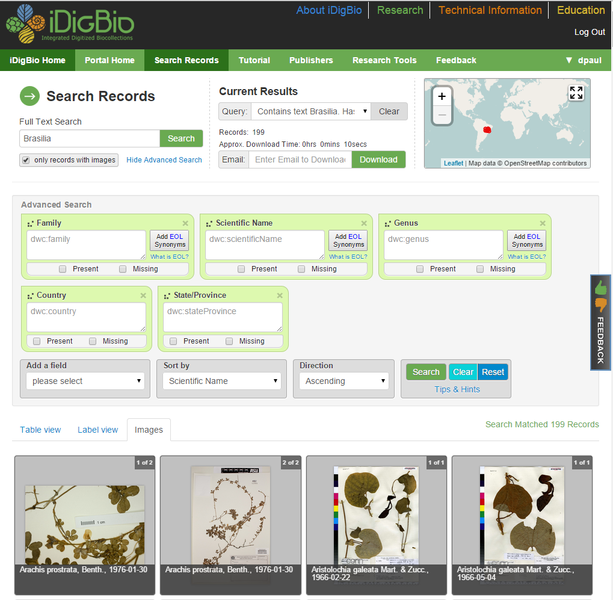
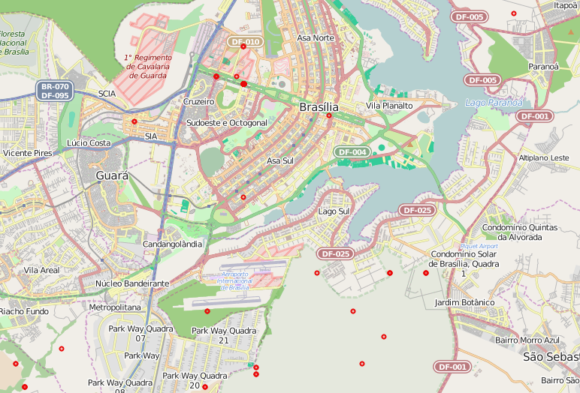
Pre-digitization Curation
Notes:
Specimens from here to eternity – no –
from your collection into a database into ours, and lots of other databases
and into papers, publications, websites,…
https://www.idigbio.org/portal/mediarecords/e45e27be-95e3-4792-8489-ebaad4a67b9b

Slide 4
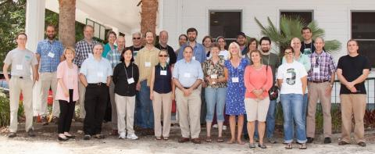
DROID Workflows Workshop
Developing Robust Object to Image to Data Workflows
Workflows by storage type
DROID1 – flat sheets
Module 1 – Pre-digitization Curation
https://www.idigbio.org/content/workflow-modules-and-task-lists
Notes:
DROID Workflows Workshop
ongoing work to typify workflows by collection storage type
creating modules for the design of efficient workflows
Check out the NEDCC.
See the following document at iDigBio for tasks of pre-digitization curation of specimens on “flat sheets.”
Many of the steps can be seen as optional. The purpose of these lists is to help collections design
efficient workflows, pointing out what can be done and what the ramifications are downstream of different choices to do a task “now” or put it off until later.
https://www.idigbio.org/sites/default/files/sites/default/files/Module_1_Pre-digitization_Curation_Tasks_0.pdf

Slide 5
Pre-Digitization Module Tasks (Part 1)
T1 – apply storage locator barcodes
T2 – selecting what to digitize
T3 – apply machine readable barcodes at collection level
T4 – locate specimens (flag cabinets)
T5 – pull specimens from cabinet*
*(optional) sort by collector, date, geography
T6 – curate collection in place (check nomenclature and annotations)
Notes:
See https://www.idigbio.org/sites/default/files/sites/default/files/Module_1_Pre-digitization_Curation_Tasks_0.pdf
for details of each task, associated options and comments.

Slide 6
Pre-Digitization Module Tasks (Part 2)
T7 – transport specimen to imaging station
T8 – placeholder to flag pulled specimens
T9 – sort to remove any already imaged / barcoded
T10 – separate specimens needing conservation work before imaging
T11 – apply barcodes
T12 – create skeletal database record
Notes:
See: https://www.idigbio.org/sites/default/files/sites/default/files/Module_1_Pre-digitization_Curation_Tasks_0.pdf
for details for these pre-digitization module tasks.

Slide 7
Deciding to Digitize
What will you digitize?
All or part of your collections
How do you decide?
Researcher-based needs
Appeal to public, outreach, preservation, conservation
Fragility
Access
Cost
Staffing
Will you be taking images? If yes, more decisions!

Slide 8
What Database?
what database, what other software (optical character recognition (OCR), voice, touch screen)? How to decide?
preparing the database
taxonomic trees / tables
getting all localities done beforehand
what kind of identifiers?
how will data be shared / exported / re-integrated?

Slide 9
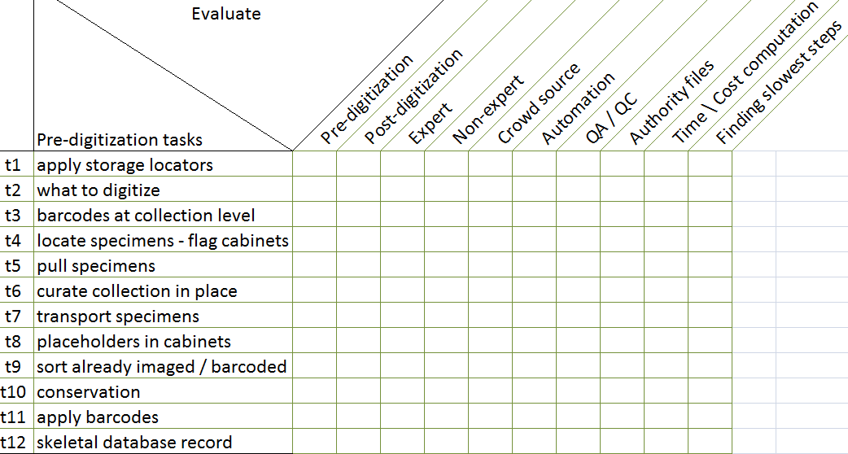
Evaluate Pre-Digitization Module Tasks
Keep staffing in mind as well as
new developments
track issues / document
decisions, opportunities, options

Slide 10
Pre-Digitization Opportunities
evaluate collection health
Profiling Natural History Collections: A Method for Quantitative and Comparative Health Assessment
hard data for museum directors & administrators
“an important tool in reinvigorating collection management and in particular providing data to support funding requests.”
finding unknown unknowns and lost material
experts or non-experts?
high-hanging fruit (or tasks perhaps long put off)
cabinet reorganization
equipment updates
loan returns
specimen repair
Not all steps require a professional
Curation is a potential bottleneck

Slide 11
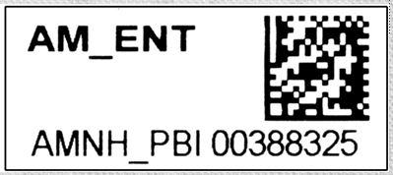
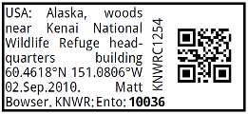
Bar Codes
Use and Content of Barcodes
Types
What suits your collection type/s?
Is all printed text on the label in the encoded part?
What ought to be in the encoding?
Will you need to re-print?
Can the barcode be seen easily (insect / wet collection issues)?
Is your barcode identifier globally unique or only unique inside your collection?
Must you use one?
They speed up processing and tracking of loans
They make automation possible for some digitization processes
Accountability
Notes:
http://www.akentsoc.org/archives/category/arctos

Slide 12
Preparing the collection – Curatorial tasks
Updating the taxonomic identifications
Or not
Updating nomenclature in the database
Tracking loans
What’s been digitized, what has not
Updating loan records
Label updates / standardization
Cabinets, drawers, trays, jars, slides
Collection health
Curation pipeline
Conservation status
Condition of labels
Data quality
Computerization level
Container condition
Incorporating new materials (gifts) waiting to be accessioned

Slide 13
Who is going to digitize?
Tasks
Potential Resources for these Tasks
Preparation
Cabinet organization
Re-pinning
Bar code application
Data Transcription
Imaging
Data Validation
Georeferencing
Determination Annotation
Enhancement
Staff
Volunteers
Public
Using Optical Character Recognition software
Voice recognition software
Touch screen technology
Light Box
Conveyor belt

Slide 14
Predigitization Unanticipated Benefits
inspect / repair / specimen damage (ipm)
collection health,
inventory collection
re-pin / remount specimens
replenish / replace preservatives
attach a unique identifier
(most often a 1- or 2-D barcode)
to a specimen, container, or cabinet
discover important but
unknown, lost, or dislocated holdings
(e.g. those owned by other institutions or the federal government)
update nomenclature and taxonomic interpretation
reorganize the cabinets, cases, trays, and containers
vet type specimens, and
select exemplars for digitization / imaging*
Notes:
Collections managers reported that pre-digitization curation
and staging also provides unanticipated benefits, including
opportunities to: (see slide)
inspect /repair / specimen damage collection health (route to conservation),
inventory collection,
re-pin / remount specimens and replenish / replace preservatives in containers,
specimen ipm,
attach a unique identifier (most often a 1- or 2-D barcode) to a specimen, container, or cabinet,
discover important but previously unknown, lost, or dislocated holdings (e.g. those owned by other institutions or the federal government),
update nomenclature and taxonomic interpretation,
reorganize the contents of cabinets, cases, trays, and containers, especially when these are the units of digitization,
vet type specimens, and
select exemplars for digitization / imaging, when that approach is appropriate.

Slide 15
Assessing Digitization Tasks
Reed Beaman, James Macklin, Michael Donoghue, James Hanken. 2007. Overcoming the Digitization Bottleneck in Natural History Collections: A summary report on a workshop held 7 – 9 September 2006 at Harvard University.
ĺñigo Granzow-de la Cerda and James H. Beach. December 2010. Semi-automated workflows for acquiring specimen data from label images in herbarium collections. Taxon 59 (6): 1830-1842
Bryan Kalms. Digitisation: A strategic approach for natural history collections. Canberra, Australia, CSIRO, 2012.
John Tann & Paul Flemons. 2008. Report: Data capture of specimen labels using volunteers. Australian Museum
Ana Vollmar, James Alexander Macklin, Linda Ford. 2010. Natural History Specimen Digitization: Challenges and Concerns. Biodiversity Informatics 7 (1): 93 – 112
Favret C, Cummings KS, McGinley RJ, Heske EJ, Johnson KP, Phillips CA, Phillippe LR, Retzer ME, Taylor CA, Wetzel MJ. 2007. Profiling Natural History Collections: A Method for Quantitative and Comparative Health Assessment. Collection Forum 22(1–2): 53 - 65
Nelson G, Paul D, Riccardi G, Mast AR 2012. Five task clusters that enable efficient and effective digitization of biological collections. In: Blagoderov V, Smith VS (Ed) No specimen left behind: mass digitization of natural history collections. ZooKeys 209: 19–45. doi: 10.3897/zookeys.209.3135
iDigBio Developing Robust Object to Image to Data (iDigBio DROID) Workshop – May 30 – 31, 2012
https://www.idigbio.org/content/workflow-modules-and-task-lists

Slide 16
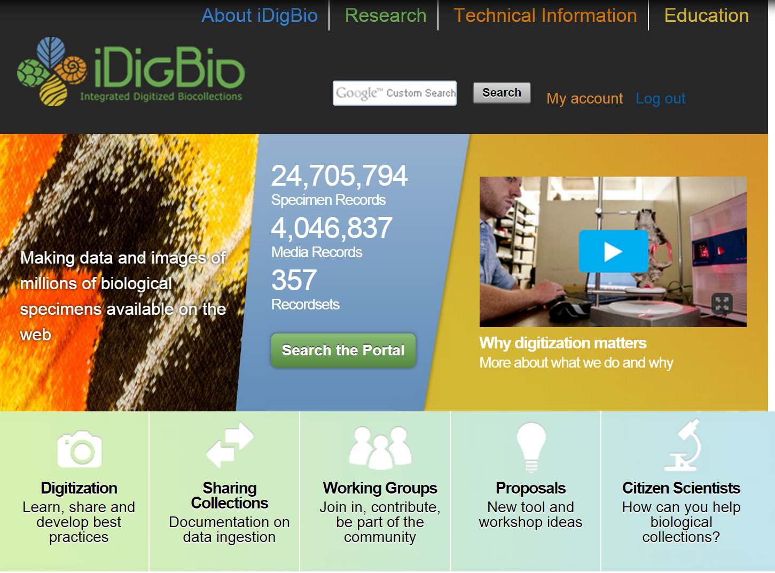
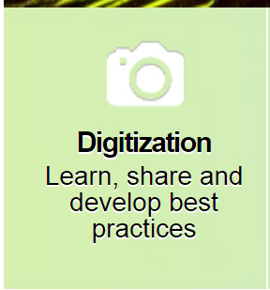

Slide 17
Obrigada SiBBr! Find out more at … https://www.idigbio.org/content/workflow-modules-and-task-lists
dpaul@fsu.edu
@idbdeb
Notes:
Task Cluster 1: Pre-digitization curation and staging
what are you going to digitize? (all, part)
curatorial tasks that have to be done
examples: organizing specimens for images, straightening out taxonomy, ...) applying identifiers
what database, what other software (OCR?)?
preparing the database
taxonomic trees / tables
getting all localities done beforehand (ent example)
what kind identifiers?
how will data be shared / exported / re-integrated
who is going to enter the data?
Staff
Volunteers
ocr & public participation (crowdsourcing, citizen science)
workflow documentation and strategies
protocol development
institutional policy
where to find this information after this talk

Slide 18
Factors for Task Order
are experts needed?
where will conservation fit in?
how will materials from conservation get back into the digitization workflow?
“filed as” or up-to-date taxonomy?
collection size factor
isolating steps that can be done after digitization
reliance on the database
“imaged” written in ink or pencil on specimen?
*how many are actively using the collection?
*how do those using the collection cooperate in this process?
Notes:
Example, using the “filed as” strategy saves a lot of time up front, but plans need to be put in place to deal with feedback from exposed exported data and update of the data after digitization.
Issues discussed with Dorothy Allard at the Reception for this workshop.
Would Yammer help those using the collection (but not seeing each other in the herbarium) help?

Slide 19
Post public/citizen science processing
Importing their (digital volunteers) work require clean up / standardization before importing into Emu
Volunteers get credit
(Get list of what they do)

Slide 20
Post-Digitization: Data Curation – Data Management
Revisualization is revealing
Querying dataset to find / fix errors
filename errors
typos
georeferencing errors
taxonomic errors
guid errors
format errors (dates)
mapping (from Workbench for example)

Slide 21
Post-Digitization
Using new tools
Kepler Kurator – Data Cleaning, Data Enhancement
Google Refine, desktop app
from messy to marvelous
http://code.google.com/p/google-refine/
remove leading / trailing white spaces
standardize values
Query / Report / Update features of Databases
Learn how to query your databases effectively
Learn MySQL
Notes:
Check out more about Kepler Kurator
http://daks.ucdavis.edu/?page_id=205
Specimen Curation Workflow with Kepler: http://www.youtube.com/watch?v=DEkPbvLsud0
From Kepler posting on web at: http://daks.ucdavis.edu/?page_id=205
Diverse services and tools can be conveniently integrated into a workflow through the actors, helping data curation in various dimensions: e.g. there are visualization services (Google Maps) which help spot quality problems in input datasets; domain-specific services (e.g., GeoLocate, IPNI, GNI, FNA) can be used to identify and correct, for example, geo-reference errors, scientific name errors, etc.; common curation operations like duplicate identification and consensus; and other useful utility services like authentication/authorization services (e.g. OAuth), data sharing services (e.g. Google Spreadsheet) and communication services (e.g. E-Mail and SMS Text Messaging) are provided as well.
Apple Pie is a project of Filtered PUSH. Annotate Specimen, Remote Data Capture, , Find Duplicates
Filtered PUSH uses Kepler Kurator.
Symbiota, Specify, Morphbank, are connected in test versions to prove the concept works.

Slide 22
Post-Digitization
Exposing Data to Outside Curation – Yipee! Feedback
Data Discovery
dupes, grey literature, more complete records, annotations of many kinds, georeferenced records
Filtered PUSH Project
Scatter, Gather, Reconcile – Specify
iDigBio
Planning for Ingestion of Feedback – Policy Decisions
re-determinations & the annotation dilemma
to re-image or not to re-image
“annotated after imaged”
to attach a physical annotation label to the specimen from a digital annotation or not (Flora of North America)
Notes:
Annotations coming back to a collection manager from the outside.
To accept or not?
If accepted – uploaded into the database as a newer determination (or historical legacy annotation) for the specimen. Place a label on the physical specimen? Re-image or not due to new annotation?

Slide 23
Post-Digitization
Managing Data Enhancement
Crowd-Sourcing
completing skeletal records
georeferencing
multi-keying
Geolocate
Symbiota
Opportunities for
Data Quality
Data Integrity
Data Enhancement
Sharing the data (the other presentation).
Everyone is looking forward to lots of new datasets!

Slide 24
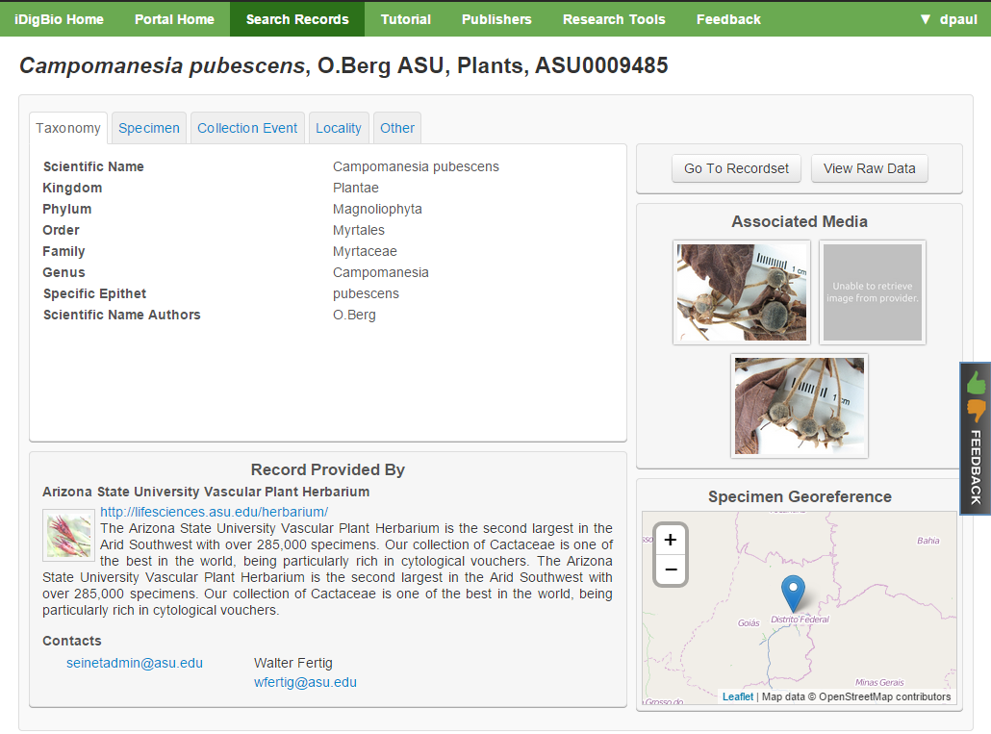
Revisualization
Notes:
https://www.idigbio.org/portal/records/1e6e07e6-7b79-4d98-801f-e6272cac2a86
Campomanesia pubescens

