Slide 1
Morphbank ~ a quick tour
Botany 2012
Columbus, OH
Deborah Paul, iDigInfo
Notes:
In this presentation, material is presented about what is possible after images and metadata inside Morphbank.
It is intended to be an introduction to the web site and the tools available in Morphbank.
While the workshop had wired access for a live DEMO, the screen shots in this talk are hyperlinked to allow the talk
to work with or without wireless (or wired) access.
The talk was presented to an audience of about 80 people at the Digitization Symposium, Thursday 12 July 2012, one day
post the Botany 2012 Conference in Columbus, Ohio.
Questions?
Please send them to: mbadmin@scs.fsu.edu

Slide 2
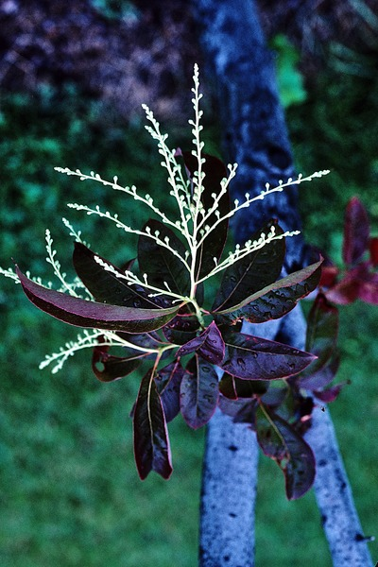
topics
Morphbank overview
linking data & images
from Morphbank
to Morphbank
annotations
in progress
Notes:
This talk focuses on what is possible once images and associated metadata are uploaded into Morphbank.
Some of the most-used features of Morphbank are the collection software, annotation software and viewer.
Morphbank contributors publishing image-illustrated scientific papers put images in Morphbank.
Once uploaded, these images, and the specimen and view metadata all have persistent unique identifiers in
the form of Morphbank URLs. The contributor controls who can see the images and when they can be
seen by the public.
Morphbank objects (e.g., images, image records, specimen records, view records,…)
can be grouped into unique albums (i.e. collections) made by any Morphbank account holder.
These albums/collections also have persistent unique identifiers. Being able to create
this collection makes it easy to put a single link in a published paper – that acts as a link
to many objects in Morphbank.
Once a paper is published, or a website is created, a Morphbank contributor may add
links from their Morphbank objects out to their published papers or websites.
Users of Morphbank may also leave notes about images in the form of annotations.
These comments may be related to the current identification of the object, or may
be a general comment or perhaps an assertion about a morphological feature in a particular image.
These annotations receive persistent URLs too and as such, can also be linked from a website
or paper, back to Morphbank.
With the development of the iDigBio cloud-based database, Morphbank is working out
plans to simplify upload to Morphbank via a DwC-A file and discussing the possibility of being able
to download a selected dataset from iDigBio into Morphbank to use Morphbank features like the
collection and annotation tools.
Image is: Oxydendrum arboreum
http://www.morphbank.net/?id=496552

Slide 3
Notes:
This talk focuses on what is possible once images and associated metadata are uploaded into Morphbank.
as of March 2012, over 352,000 images
over 19,000 distinct taxa
Animalia over 8,500 distinct taxa
Plantae over 10,400 distinct taxa
615+ members
from more than 45 countries
Morphbank is in essence an image repository with additional features to extend the usefulness of the images and metadata.
Morphbank started out as an ftp site in 1998 and was designed by a group of entomologists as collaborative effort to elucidate higher-level relationships in the parasitic-wasp superfamily Cynipoidea.
Would-be contributors request an account via an automated account request system.
With an account, users can begin uploading data and images and using the features discussed in this presentation.
Some of the most-used features of Morphbank are the collection software, annotation software and viewer.
Morphbank contributors publishing image-illustrated scientific papers put images in Morphbank.
Once uploaded, these images, and the specimen and view metadata all have persistent unique identifiers in
the form of Morphbank URLs. The contributor controls who can see the images and when they can be
seen by the public.
Morphbank objects (e.g., images, image records, specimen records, view records,…)
can be grouped into unique albums (i.e. collections) made by any Morphbank account holder.
These albums/collections also have persistent unique identifiers. Being able to create
this collection makes it easy to put a single link in a published paper – that acts as a link
to many objects in Morphbank.
Once a paper is published, or a website is created, a Morphbank contributor may add
links from their Morphbank objects out to their published papers or websites.
Users of Morphbank may also leave notes about images in the form of annotations.
These comments may be related to the current identification of the object, or may
be a general comment or perhaps an assertion about a morphological feature in a particular image.
These annotations receive persistent URLs too and as such, can also be linked from a website
or paper, back to Morphbank.
With the development of the iDigBio cloud-based database, Morphbank is working out
plans to simplify upload to Morphbank via a DwC-A file and discussing the possibility of being able
to download a selected dataset from iDigBio into Morphbank to use Morphbank features like the
collection and annotation tools. Once this is done, any annotations could then be shared with iDigBio
for repatriation to the provider.

Slide 4
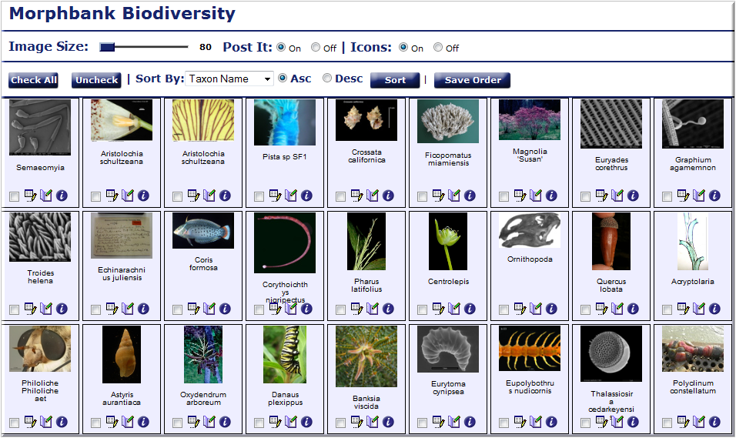
http://www.morphbank.net/?id=796533
Notes:
One of the most used features of Morphbank, the collection.
Users create them and a unique id is assigned to that collection.
The URL can then be used, for example, in a paper to link the user reading the paper back to the collection in Morphbank to see more images and have the ability to make comments (i.e., annotations).
Images here include wasps, flies, carnivorous plants, polychaetes, cnidaria, diatoms, arachnids, cypriniform fish, and dinosaurs.
Click on the collection, or the hyperlink to see the collection inside Morphbank.
Click the “I” icon to see metadata, click the image for access to a larger version of the image…

Slide 5
topics
Morphbank overview
linking data & images
from Morphbank
to Morphbank
annotations
in progress
Notes:
This talk focuses on what is possible once images and associated metadata are uploaded into Morphbank.
Some of the most-used features of Morphbank are the collection software, annotation software and viewer.
Morphbank contributors publishing image-illustrated scientific papers put images in Morphbank.
Once uploaded, these images, and the specimen and view metadata all have persistent unique identifiers in
the form of Morphbank URLs. The contributor controls who can see the images and when they can be
seen by the public.
Morphbank objects (e.g., images, image records, specimen records, view records,…)
can be grouped into unique albums (i.e. collections) made by any Morphbank account holder.
These albums/collections also have persistent unique identifiers. Being able to create
this collection makes it easy to put a single link in a published paper – that acts as a link
to many objects in Morphbank.
Once a paper is published, or a website is created, a Morphbank contributor may add
links from their Morphbank objects out to their published papers or websites.
Users of Morphbank may also leave notes about images in the form of annotations.
These comments may be related to the current identification of the object, or may
be a general comment or perhaps an assertion about a morphological feature in a particular image.
These annotations receive persistent URLs too and as such, can also be linked from a website
or paper, back to Morphbank.
With the development of the iDigBio cloud-based database, Morphbank is working out
plans to simplify upload to Morphbank via a DwC-A file and discussing the possibility of being able
to download a selected dataset from iDigBio into Morphbank to use Morphbank features like the
collection and annotation tools.
Image is: Oxydendrum arboreum
http://www.morphbank.net/?id=496552

Slide 6
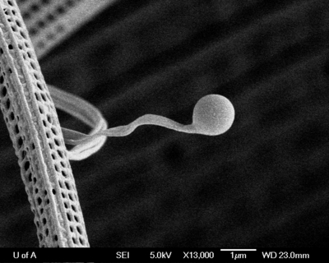
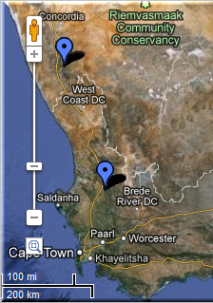
linking
aggregators
ontologies
publications
maps
databases
provider websites
FilteredPUSH
GenBank ®
Cladistics ®
Notes:
This talk focuses on what is possible once images and associated metadata are uploaded into Morphbank.
In this slide, we see just some of the places where images are linked back to Morphbank and places where
Morphbank images are linked to.
Some of the most-used features of Morphbank are the collection software, annotation software and viewer.
Morphbank contributors publishing image-illustrated scientific papers put images in Morphbank.
Once uploaded, these images, and the specimen and view metadata all have persistent unique identifiers in
the form of Morphbank URLs. The contributor controls who can see the images and when they can be
seen by the public.
Morphbank objects (e.g., images, image records, specimen records, view records,…)
can be grouped into unique albums (i.e. collections) made by any Morphbank account holder.
These albums/collections also have persistent unique identifiers. Being able to create
this collection makes it easy to put a single link in a published paper – that acts as a link
to many objects in Morphbank.
Once a paper is published, or a website is created, a Morphbank contributor may add
links from their Morphbank objects out to their published papers or websites.
Users of Morphbank may also leave notes about images in the form of annotations.
These comments may be related to the current identification of the object, or may
be a general comment or perhaps an assertion about a morphological feature in a particular image.
These annotations receive persistent URLs too and as such, can also be linked from a website
or paper, back to Morphbank.
With the development of the iDigBio cloud-based database, Morphbank is working out
plans to simplify upload to Morphbank via a DwC-A file and discussing the possibility of being able
to download a selected dataset from iDigBio into Morphbank to use Morphbank features like the
collection and annotation tools.
Graphium agamemnon
http://www.morphbank.net/?id=592558
Please quote the following publication if you use the image: Simonsen, T. J., Zakharov, E. V., Djernaes, M., Cotton, A., Vane-Wright, R. I. & Sperling, F. A. H. (2011). Phylogeny, host plant associations and divergence time of Papilioninae (Lepidoptera: Papilionidae) inferred from morphology and seven genes with special focus on the enigmatic genera Teinopalpus and Meandrusa. Cladistics. 27: pp. 113-137.

Slide 7
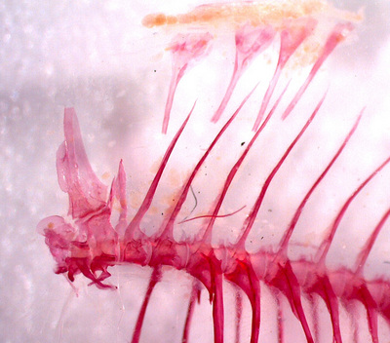
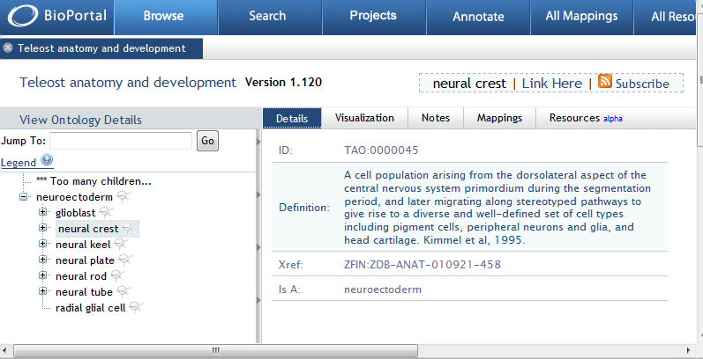
linking to ontologies
Cypriniform Tree of Life (CToL)
http://www.morphbank.net/?id=459818
Notes:
Images in Morphbank can be linked to hosted ontologies like those at bioportal to illustrate the terms in the hierarchical structure.
The Cypriniform Tree of Life project (CToL) is an example…their Teolost Anatomy Ontology (TAO) is at BioPortal. Images in Morphbank link to the TAO ontology as illustrated in this slide.
Clicking on the image, or the hyperlink > opens the record in Morphbank.
Inside that record, there’s a link to the TAO Ontology related term in the hierarchy.

Slide 8
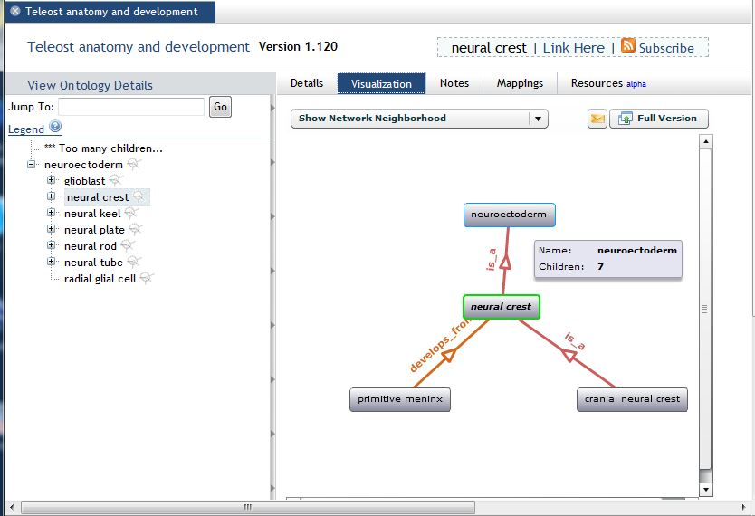
linking to ontologies
Cypriniform Tree of Life (CToL)
http://www.morphbank.net/?id=459818
Notes:
Images in Morphbank can be linked to hosted ontologies like those at bioportal to illustrate the terms in the hierarchical structure.
The Cypriniform Tree of Life project (CToL) is an example…their Teolost Anatomy Ontology (TAO) is at BioPortal. Images in Morphbank link to the TAO ontology as illustrated in this slide.
Clicking on the image, or the hyperlink > opens the record in Morphbank.
Inside that record, there’s a link to the TAO Ontology related term in the hierarchy.

Slide 9
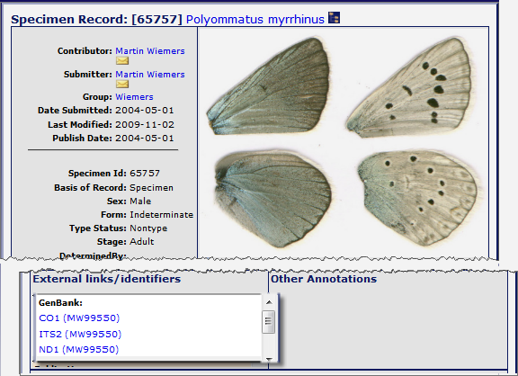
linking to genbank
Notes:
http://www.morphbank.net/?id=65757 linked to CO1 (MW99550) at http://www.ncbi.nlm.nih.gov/nucleotide/AY557122 (genbank)
genbank entry at http://www.ncbi.nlm.nih.gov/nucleotide/AY557122 is linked to http://morphbank.net/?id=65757
Morphbank contributors publishing image-illustrated scientific papers put images in Morphbank.
Once uploaded, these images, and the specimen and view metadata all have persistent unique identifiers in
the form of Morphbank URLs. The contributor controls who can see the images and when they can be
seen by the public.
Morphbank objects (e.g., images, image records, specimen records, view records,…)
can be grouped into unique albums (i.e. collections) made by any Morphbank account holder.
These albums/collections also have persistent unique identifiers. Being able to create
this collection makes it easy to put a single link in a published paper – that acts as a link
to many objects in Morphbank.
Once a paper is published, or a website is created, a Morphbank contributor may add
links from their Morphbank objects out to their published papers or websites.
In this slide, following the URLs, from a morphbank object to either
the genbank links or link to the
published paper relating to these images.

Slide 10
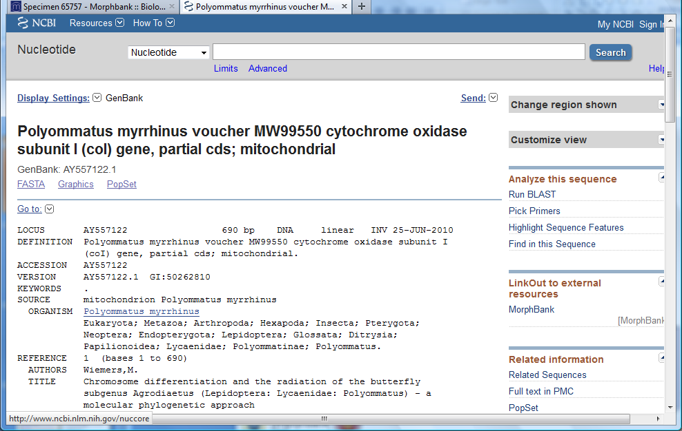
linking to genbank
Notes:
http://www.morphbank.net/?id=65757 linked to CO1 (MW99550) at http://www.ncbi.nlm.nih.gov/nucleotide/AY557122 (genbank)
genbank entry at http://www.ncbi.nlm.nih.gov/nucleotide/AY557122 is linked to http://morphbank.net/?id=65757
Morphbank contributors publishing image-illustrated scientific papers put images in Morphbank.
Once uploaded, these images, and the specimen and view metadata all have persistent unique identifiers in
the form of Morphbank URLs. The contributor controls who can see the images and when they can be
seen by the public.
Morphbank objects (e.g., images, image records, specimen records, view records,…)
can be grouped into unique albums (i.e. collections) made by any Morphbank account holder.
These albums/collections also have persistent unique identifiers. Being able to create
this collection makes it easy to put a single link in a published paper – that acts as a link
to many objects in Morphbank.
Once a paper is published, or a website is created, a Morphbank contributor may add
links from their Morphbank objects out to their published papers or websites.
In this slide, following the URLs, from a morphbank object to either
the genbank links or link to the
published paper relating to these images.

Slide 11
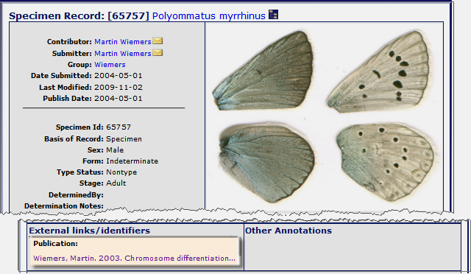
linking to publications
Notes:
http://www.morphbank.net/?id=65757 linked to paper
http://nbn-resolving.de/urn:nbn:de:hbz:5n-02787
Morphbank contributors publishing image-illustrated scientific papers put images in Morphbank.
Once uploaded, these images, and the specimen and view metadata all have persistent unique identifiers in
the form of Morphbank URLs. The contributor controls who can see the images and when they can be
seen by the public.
Morphbank objects (e.g., images, image records, specimen records, view records,…)
can be grouped into unique albums (i.e. collections) made by any Morphbank account holder.
These albums/collections also have persistent unique identifiers. Being able to create
this collection makes it easy to put a single link in a published paper – that acts as a link
to many objects in Morphbank.
Once a paper is published, or a website is created, a Morphbank contributor may add
links from their Morphbank objects out to their published papers or websites.
In this slide, following the URLs, from a morphbank object to either the genbank links or link to the published paper relating to these images
from the Morphbank URL http://www.morphbank.net/?id=65757

Slide 12
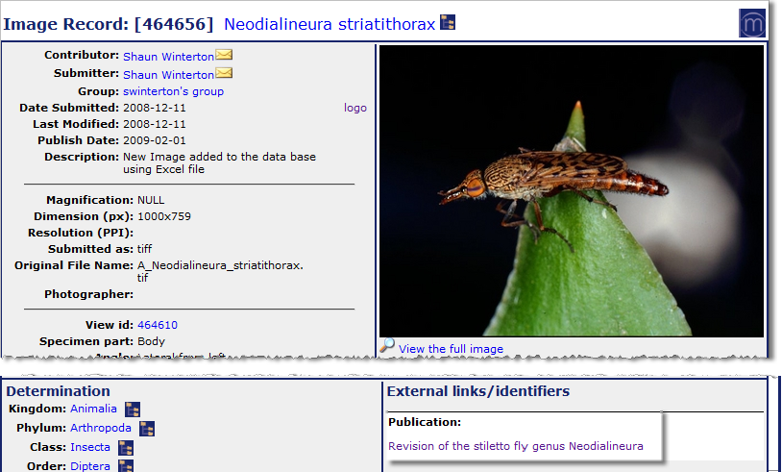
linking to publications
http://www.morphbank.net/?id=464656
Notes:
An image (and related data) stored in Morphbank, linked to a paper. (the paper is linked back to the images in Morphbank).
http://www.morphbank.net/?id=464656
http://www.mapress.com/zootaxa/2009/f/zt02157p033.pdf

Slide 13
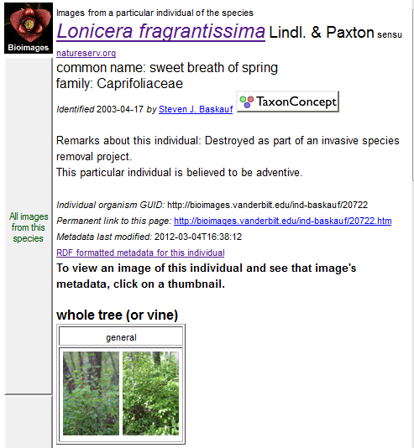
linking from Morphbank to provider website
http://www.morphbank.net/?id=786176
Lonicera fragrantissima
Notes:
An image (and related data) stored in Morphbank, linked to a provider’s website with additional metadata and links.
http://www.morphbank.net/?id=786176
links to: Image metadata for GUID http://bioimages.vanderbilt.edu/baskauf/21023 http://bioimages.vanderbilt.edu/baskauf/21023
and
links to: Organism metadata for GUID http://bioimages.vanderbilt.edu/ind-baskauf/20722 http://bioimages.vanderbilt.edu/ind-baskauf/20722
Note the screen shots in this slide are hyperlinked to their respective web pages.

Slide 14
topics
Morphbank overview
linking data & images
from Morphbank
to Morphbank
annotations
in progress
Notes:
This talk focuses on what is possible once images and associated metadata are uploaded into Morphbank.
Some of the most-used features of Morphbank are the collection software, annotation software and viewer.
Morphbank contributors publishing image-illustrated scientific papers put images in Morphbank.
Once uploaded, these images, and the specimen and view metadata all have persistent unique identifiers in
the form of Morphbank URLs. The contributor controls who can see the images and when they can be
seen by the public.
Morphbank objects (e.g., images, image records, specimen records, view records,…)
can be grouped into unique albums (i.e. collections) made by any Morphbank account holder.
These albums/collections also have persistent unique identifiers. Being able to create
this collection makes it easy to put a single link in a published paper – that acts as a link
to many objects in Morphbank.
Once a paper is published, or a website is created, a Morphbank contributor may add
links from their Morphbank objects out to their published papers or websites.
Users of Morphbank may also leave notes about images in the form of annotations.
These comments may be related to the current identification of the object, or may
be a general comment or perhaps an assertion about a morphological feature in a particular image.
These annotations receive persistent URLs too and as such, can also be linked from a website
or paper, back to Morphbank.
With the development of the iDigBio cloud-based database, Morphbank is working out
plans to simplify upload to Morphbank via a DwC-A file and discussing the possibility of being able
to download a selected dataset from iDigBio into Morphbank to use Morphbank features like the
collection and annotation tools.

Slide 15
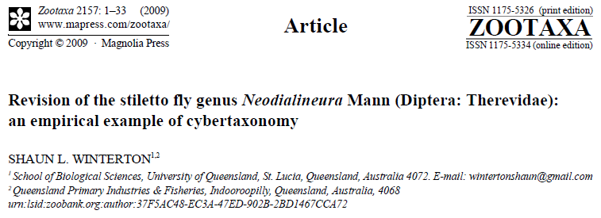
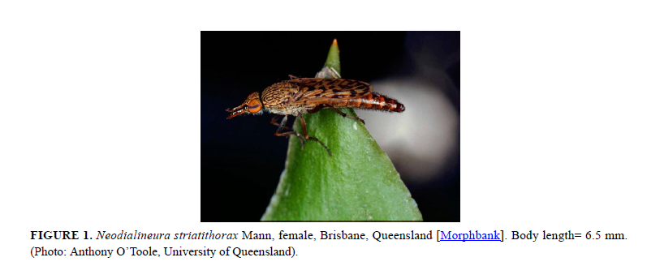
linking from a paper
http://www.mapress.com/zootaxa/2009/f/zt02157p033.pdf
http://www.morphbank.net/?id=464656
Notes:
http://www.morphbank.net/?id=464656
http://www.mapress.com/zootaxa/2009/f/zt02157p033.pdf
The Illustration of an image in a published article with a link back to the image record in Morphbank.

Slide 16
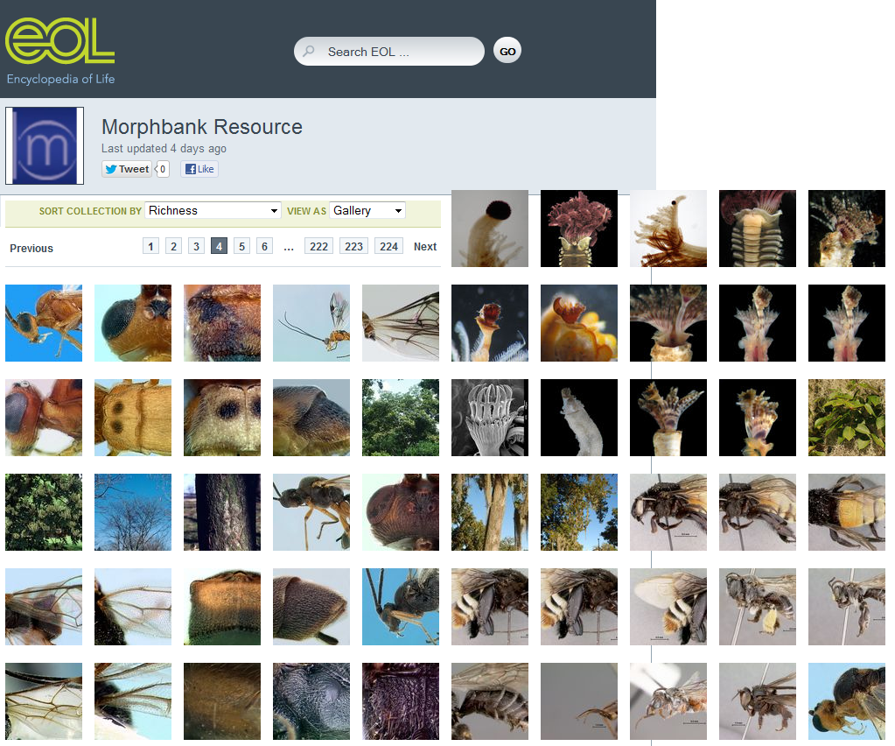
Notes:
Morphbank shares images with eol.
Currently as of July 2012, there are some 34,000 images from Morphbank going to EoL.
Users of Morphbank determine whether or not their images go to EoL.

Slide 17
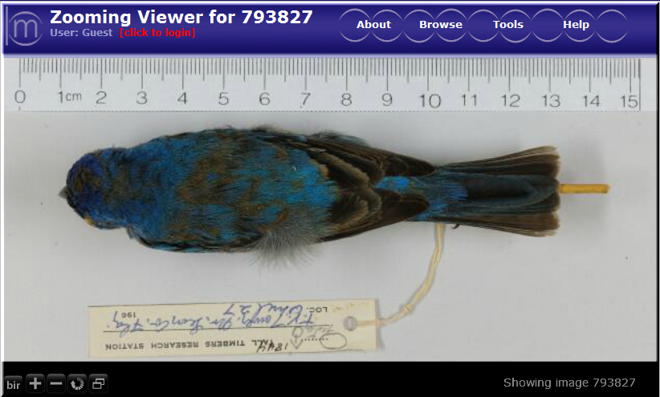
Notes:
From the Tall Timbers Research Station and Land Conservancy
ornithology dataset uploaded to GBIF. Images in Morphbank
linked via URL.
Search at GBIF is: TTRS dataset
limit to records with image URLs
limit to genus = Passerina cyanea
link is via the Morphbank Specimen record http://www.morphbank.net/?id=793828
which has links to 3 images (dorsal, ventral, lateral) for that specimen
http://www.morphbank.net/?id=793827
http://www.morphbank.net/?id=795097
http://www.morphbank.net/?id=796027
Note the Screen Shots are hyperlinked to their respective pages.
Clicking on the GBIF website screen shot will perform the search and take the user to the results page in GBIF.
Clicking on the “View” link shows a URL link back to the image/s in Morphbank.

Slide 18
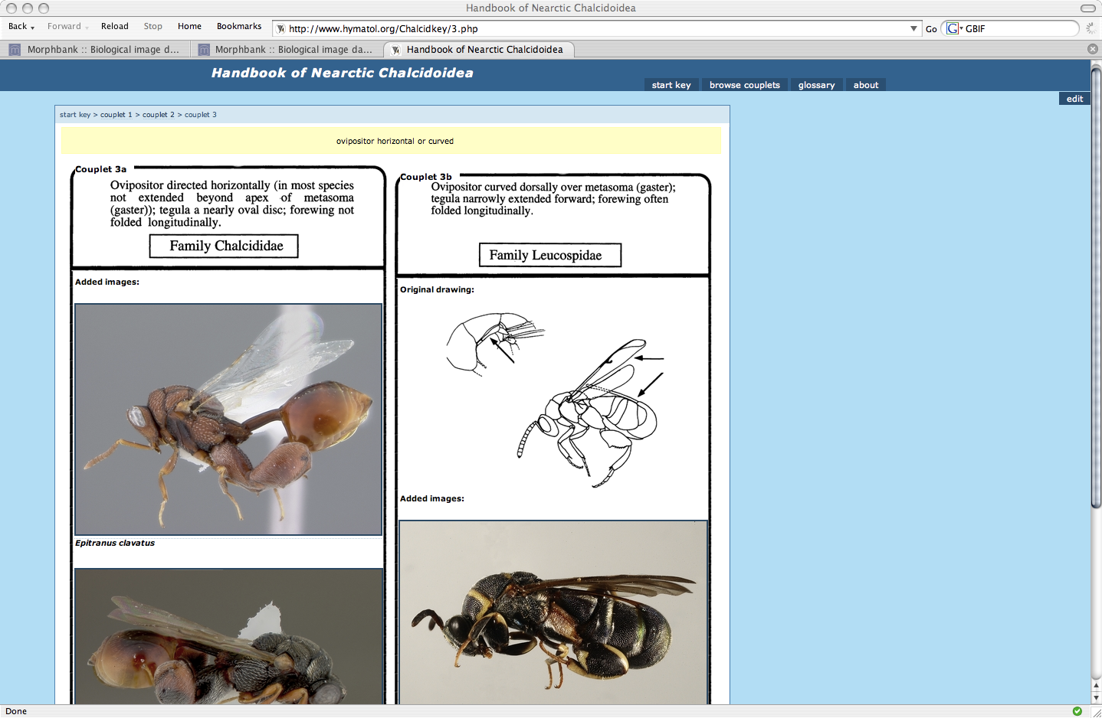
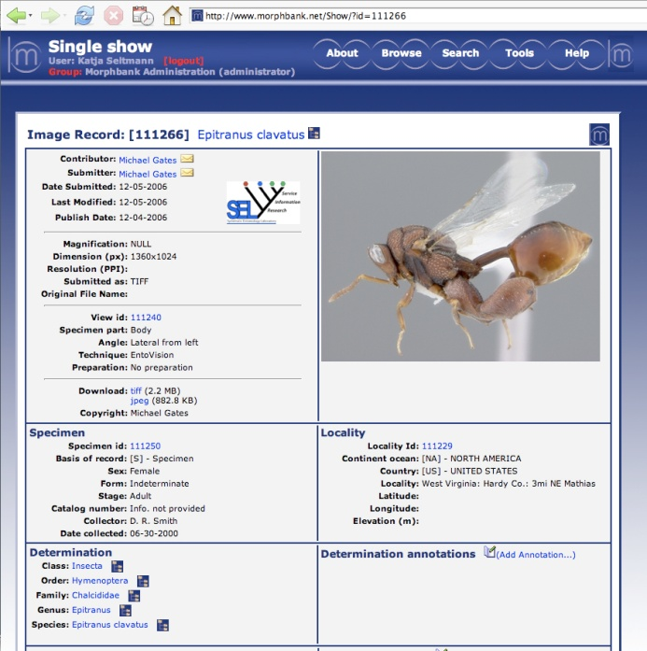
linking from a key
E. Grissell, M. E. Schauff & Mike Gates
http://www.morphbank.net/?id=111266
Notes:
Here’s an example of an online illustrated key. The images are linked to data records in Morphbank.
The image records in Morphbank are linked back to the key.
http://www.morphbank.net/?id=111266&imgType=jpeg
Software called mx, utilized widely by the entomology community uses web services of Morphbank
to find images of interest to populate their matrices (taxa x character) and keys.

Slide 19
topics
morphbank overview
linking data & images
from morphbank
to morphbank
annotations
in progress
Notes:
This talk focuses on what is possible once images and associated metadata are uploaded into Morphbank.
Some of the most-used features of Morphbank are the collection software, annotation software and viewer.
Morphbank contributors publishing image-illustrated scientific papers put images in Morphbank.
Once uploaded, these images, and the specimen and view metadata all have persistent unique identifiers in
the form of Morphbank URLs. The contributor controls who can see the images and when they can be
seen by the public.
Morphbank objects (e.g., images, image records, specimen records, view records,…)
can be grouped into unique albums (i.e. collections) made by any Morphbank account holder.
These albums/collections also have persistent unique identifiers. Being able to create
this collection makes it easy to put a single link in a published paper – that acts as a link
to many objects in Morphbank.
Once a paper is published, or a website is created, a Morphbank contributor may add
links from their Morphbank objects out to their published papers or websites.
Users of Morphbank may also leave notes about images in the form of annotations.
These comments may be related to the current identification of the object, or may
be a general comment or perhaps an assertion about a morphological feature in a particular image.
These annotations receive persistent URLs too and as such, can also be linked from a website
or paper, back to Morphbank.
With the development of the iDigBio cloud-based database, Morphbank is working out
plans to simplify upload to Morphbank via a DwC-A file and discussing the possibility of being able
to download a selected dataset from iDigBio into Morphbank to use Morphbank features like the
collection and annotation tools.

Slide 20
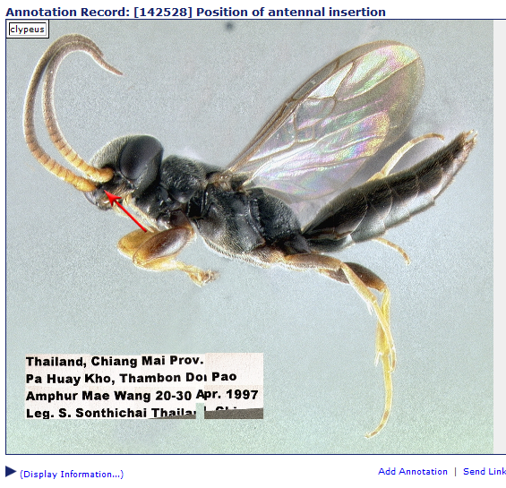
annotations
http://www.morphbank.net/?id=142528
Notes:
This talk focuses on what is possible once images and associated metadata are uploaded into Morphbank.
Some of the most-used features of Morphbank are the collection software, annotation software and viewer.
Once images are in Morphbank, a user (contributor or logged in user) can annotate images.
These could be determination annotations or perhaps a general annotation.
These annotations receive unique identifiers too and can then be shared in publications or via email
to other collaborators, for example.
Morphbank contributors publishing image-illustrated scientific papers put images in Morphbank.
Once uploaded, these images, and the specimen and view metadata all have persistent unique identifiers in
the form of Morphbank URLs. The contributor controls who can see the images and when they can be
seen by the public.
Morphbank objects (e.g., images, image records, specimen records, view records,…)
can be grouped into unique albums (i.e. collections) made by any Morphbank account holder.
These albums/collections also have persistent unique identifiers. Being able to create
this collection makes it easy to put a single link in a published paper – that acts as a link
to many objects in Morphbank.
Once a paper is published, or a website is created, a Morphbank contributor may add
links from their Morphbank objects out to their published papers or websites.
Users of Morphbank may also leave notes about images in the form of annotations.
These comments may be related to the current identification of the object, or may
be a general comment or perhaps an assertion about a morphological feature in a particular image.
These annotations receive persistent URLs too and as such, can also be linked from a website
or paper, back to Morphbank.
With the development of the iDigBio cloud-based database, Morphbank is working out
plans to simplify upload to Morphbank via a DwC-A file and discussing the possibility of being able
to download a selected dataset from iDigBio into Morphbank to use Morphbank features like the
collection and annotation tools.

Slide 21
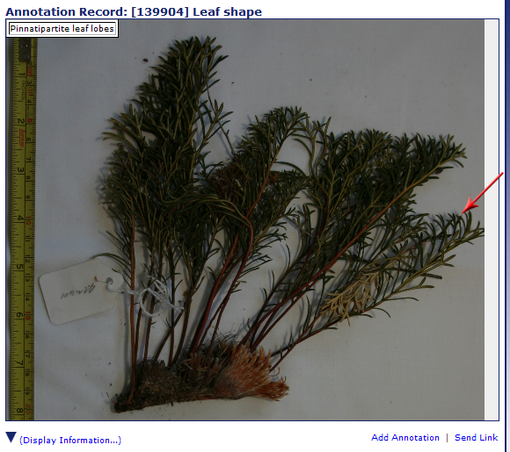
annotations
http://www.morphbank.net/?id=139904
Notes:
This talk focuses on what is possible once images and associated metadata are uploaded into Morphbank.
Some of the most-used features of Morphbank are the collection software, annotation software and viewer.
Morphbank contributors publishing image-illustrated scientific papers put images in Morphbank.
Once uploaded, these images, and the specimen and view metadata all have persistent unique identifiers in
the form of Morphbank URLs. The contributor controls who can see the images and when they can be
seen by the public.
Morphbank objects (e.g., images, image records, specimen records, view records,…)
can be grouped into unique albums (i.e. collections) made by any Morphbank account holder.
These albums/collections also have persistent unique identifiers. Being able to create
this collection makes it easy to put a single link in a published paper – that acts as a link
to many objects in Morphbank.
Once a paper is published, or a website is created, a Morphbank contributor may add
links from their Morphbank objects out to their published papers or websites.
Users of Morphbank may also leave notes about images in the form of annotations.
These comments may be related to the current identification of the object, or may
be a general comment or perhaps an assertion about a morphological feature in a particular image.
These annotations receive persistent URLs too and as such, can also be linked from a website
or paper, back to Morphbank.
With the development of the iDigBio cloud-based database, Morphbank is working out
plans to simplify upload to Morphbank via a DwC-A file and discussing the possibility of being able
to download a selected dataset from iDigBio into Morphbank to use Morphbank features like the
collection and annotation tools.

Slide 22
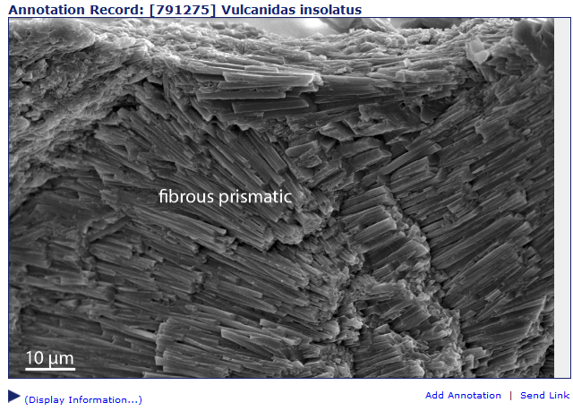
annotations
http://www.morphbank.net/582402
Notes:
This talk focuses on what is possible once images and associated metadata are uploaded into Morphbank.
Some of the most-used features of Morphbank are the collection software, annotation software and viewer.
Morphbank contributors publishing image-illustrated scientific papers put images in Morphbank.
Once uploaded, these images, and the specimen and view metadata all have persistent unique identifiers in
the form of Morphbank URLs. The contributor controls who can see the images and when they can be
seen by the public.
Morphbank objects (e.g., images, image records, specimen records, view records,…)
can be grouped into unique albums (i.e. collections) made by any Morphbank account holder.
These albums/collections also have persistent unique identifiers. Being able to create
this collection makes it easy to put a single link in a published paper – that acts as a link
to many objects in Morphbank.
Once a paper is published, or a website is created, a Morphbank contributor may add
links from their Morphbank objects out to their published papers or websites.
Users of Morphbank may also leave notes about images in the form of annotations.
These comments may be related to the current identification of the object, or may
be a general comment or perhaps an assertion about a morphological feature in a particular image.
These annotations receive persistent URLs too and as such, can also be linked from a website
or paper, back to Morphbank.
With the development of the iDigBio cloud-based database, Morphbank is working out
plans to simplify upload to Morphbank via a DwC-A file and discussing the possibility of being able
to download a selected dataset from iDigBio into Morphbank to use Morphbank features like the
collection and annotation tools.

Slide 23
topics
morphbank overview
linking data & images
from morphbank
to morphbank
annotations
in progress
Notes:
This talk focuses on what is possible once images and associated metadata are uploaded into Morphbank.
Some of the most-used features of Morphbank are the collection software, annotation software and viewer.
Morphbank contributors publishing image-illustrated scientific papers put images in Morphbank.
Once uploaded, these images, and the specimen and view metadata all have persistent unique identifiers in
the form of Morphbank URLs. The contributor controls who can see the images and when they can be
seen by the public.
Morphbank objects (e.g., images, image records, specimen records, view records,…)
can be grouped into unique albums (i.e. collections) made by any Morphbank account holder.
These albums/collections also have persistent unique identifiers. Being able to create
this collection makes it easy to put a single link in a published paper – that acts as a link
to many objects in Morphbank.
Once a paper is published, or a website is created, a Morphbank contributor may add
links from their Morphbank objects out to their published papers or websites.
Users of Morphbank may also leave notes about images in the form of annotations.
These comments may be related to the current identification of the object, or may
be a general comment or perhaps an assertion about a morphological feature in a particular image.
These annotations receive persistent URLs too and as such, can also be linked from a website
or paper, back to Morphbank.
With the development of the iDigBio cloud-based database, Morphbank is working out
plans to simplify upload to Morphbank via a DwC-A file and discussing the possibility of being able
to download a selected dataset from iDigBio into Morphbank to use Morphbank features like the
collection and annotation tools.

Slide 24
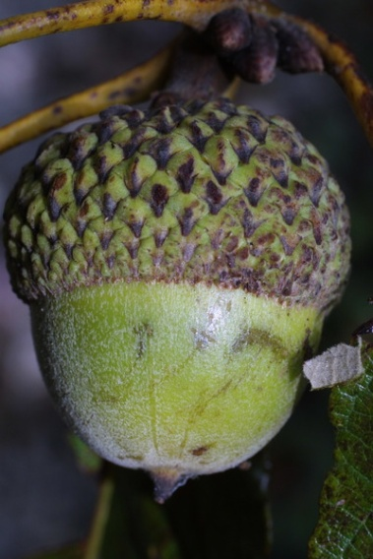
new & in development
http://services.morphbank.net/mb3/
validation service
two new Upload methods
from Specify (prototype)
working on upload from a DwC-A file
new Morphbank shared folder service
in development
FilteredPUSH testing
in progress
Morphbank V4 (Drupal)
Notes:
Moving in the excel workbook direction to allow future uploads via services. Moving overall towards services – and thinking about interoperability.
Changes we’ve made: Fewer required fields.
Working on: display restricted to group items by default
New features:
automated account creation
new workbook enabling User-defined fields,
Unique identification from provider,
Morphbank as an Image provider through services
Validation of workbooks
Several methods exist to upload images to Morphbank. Some are suited for small data sets, others well suited to large data sets.
Our web services now provide users feedback on their data before ingestion. Once the dataset clears the validation process,
users send the excel workbooks to Morphbank for upload. http://services.morphbank.net/mb3/validateXls.jsp
Upload via the web (for system administrators).
Filtered PUSH to return annotations to providers.
Bulk upload of images via morphbank user name and log in (instead of ftp).
Upload from Specify into Morphbank via a plug in.

Slide 25
integration with
iDigBio – primary repository for data discovery
import to a local instance of Morphbank
updates and annotations shared
iDigBio updates / annotations to Morphbank
Morphbank updates / annotations to iDigBio
push local records to iDigBio
Notes:
Integration with iDigBio.
With iDigBio as the primary repository for specimen data discovery,
Morphbank is working on creating a local instance, a desk top version
allowing an individual browsing iDigBio to import records and images
from iDigBio into Morphbank.
Updates and Annotations would be shared from iDigBio to Morphbank
and vice-versa.
Local records inside a desk top version of Morphbank could then be pushed to iDigBio.

Slide 26
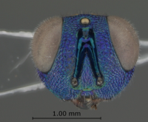
acknowledgements
Morphbank Contributors & Collaborators
CBG, AToL, PEET, PBI, MX, HERBIS, CToL, PlantCollections Project, SERNEC, FSU, PlatyPBI, SAIN, UAM, EoL, Specify, USMS, TTRS, Bioimages, Auburn, Troy, Ohio State, USM, LA NHM, Smithsonian, TTRS, USD, …
Notes:
Integration with iDigBio.
With iDigBio as the primary repository for specimen data discovery,
Morphbank is working on creating a local instance, a desk top version
allowing an individual browsing iDigBio to import records and images
from iDigBio into Morphbank.
Updates and Annotations would be shared from iDigBio to Morphbank
and vice-versa.
Local records inside a desk top version of Morphbank could then be pushed to iDigBio.

Slide 27
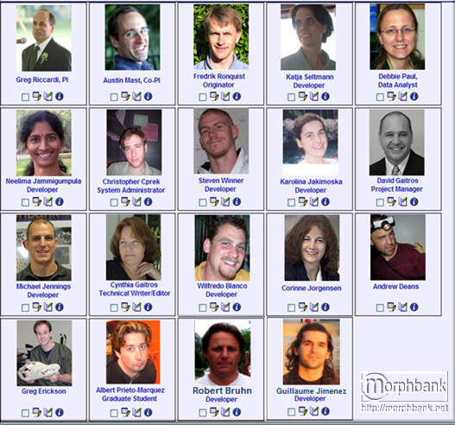
Thanks from the Morphbank Team ~ 2012
Greg Riccardi
Austin Mast
Fredrik Ronquist
Debbie Paul
Robert Bruhn
Guillaume Jimenez
Casey McLaughlin
Steven Winner
Katja Seltmann
Albert Prieto-Marquez
Corinne Jorgensen
Michael Jennings
Neelima Jammigumpula
Karolina Jakimoska
David Gaitros
Cynthia Gaitros
Greg Erickson
Andrew Deans
Christopher Cprek
Wilfredo Blanco
Notes:
Persons highlighted in bold are currently active with Morphbank in 2012.

