Slide 1
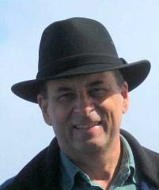
Update from the
HUB
Entomological Society of America (ESA)
Systematics, Evolution, and Biodiversity (SysEB) Section Symposium:
From Voucher Specimen to Climate Change: The Merging of Systematics and Ecology
November 13th, 2012 Knoxville, TN
Debbie Paul, Greg Riccardi, Gil Nelson
www.iDigBio.org

Slide 2
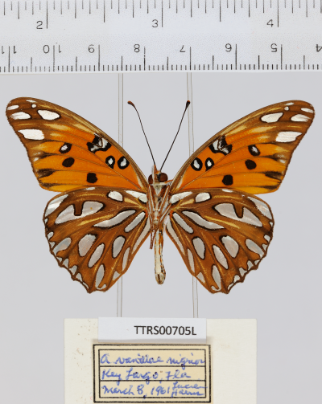
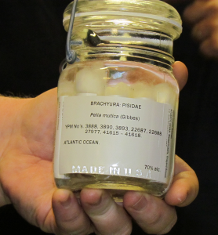
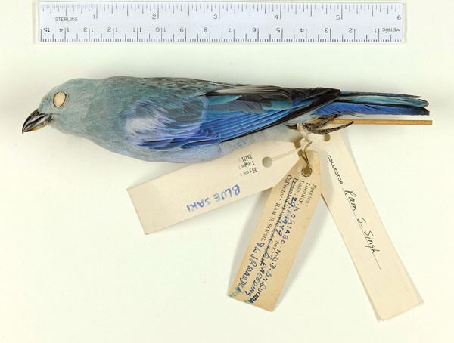
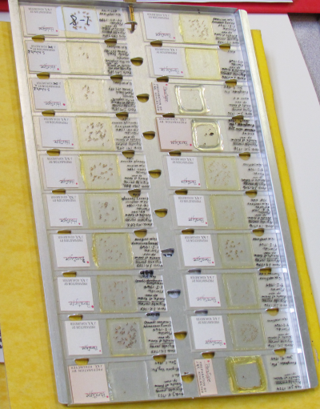
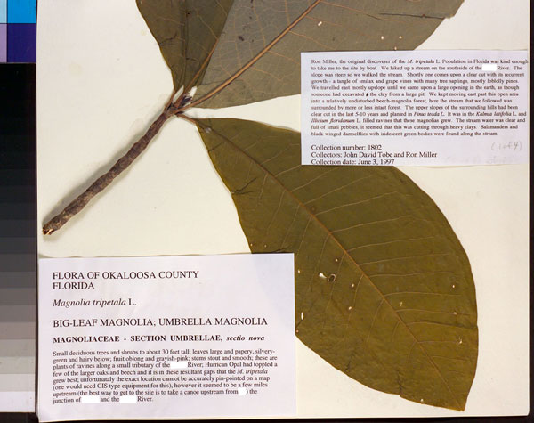
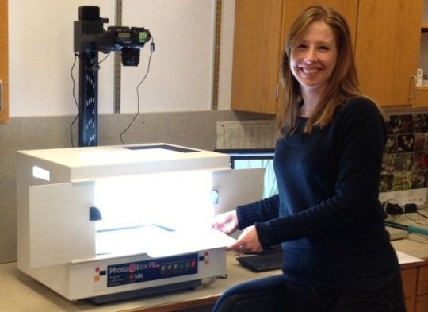
University of Florida
Florida State University
www.iDigBio.org

Slide 3
Advancing Digitization of Biodiversity Collections
Facilitate use of biodiversity data to address environmental and economic
challenges
Researchers
Educators
General public
Policy-makers
Enable digitization of biodiversity collections data
Develop efficient and effective digitization standards and workflows
Respond to cyberinfrastructure needs
Provide portal access to biodiversity data in a cloud-computing environment
Plan for long-term sustainability of the national digitization effort
Expand participation: partners and data sources
Notes:
Network Integrated BioCollections Alliance

Slide 4
Seven Thematic Collections Networks (TCNs)
InvertNet: An Integrative Platform for Research on Environmental Change, Species Discovery and
Identification (Illinois Natural History Survey, University of Illinois) http://invertnet.org
Plants, Herbivores, and Parasitoids: A Model System for the Study of Tri-Trophic Associations (American Museum of Natural History) http://tcn.amnh.org
North American Lichens and Bryophytes: Sensitive Indicators of Environmental Quality and Change (University of Wisconsin – Madison) http://symbiota.org/nalichens/index.php http://symbiota.org/bryophytes/index.php
Digitizing Fossils to Enable New Syntheses in Biogeography-Creating a PALEONICHES-TCN (University of Kansas)
The Macrofungi Collection Consortium: Unlocking a Biodiversity Resource for Understanding Biotic Interactions, Nutrient Cycling and Human Affairs (New York Botanical Garden)
Mobilizing New England Vascular Plant Specimen Data to Track Environmental Change (Yale University)
Southwest Collections of Arthropods Network (SCAN): A Model for Collections Digitization to Promote Taxonomic and Ecological Research (Northern Arizona University)
http://hasbrouck.asu.edu/symbiota/portal/index.php

Slide 5
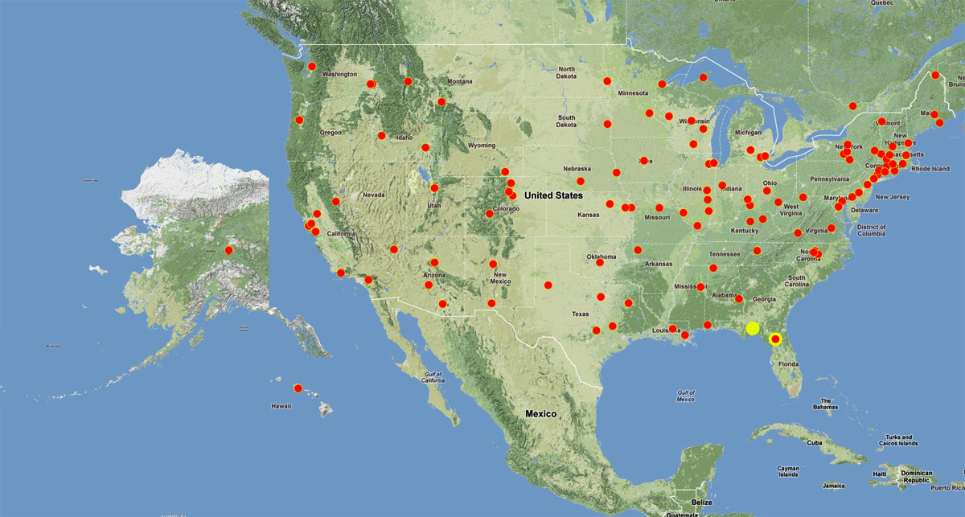
National Resource (iDigBio), Thematic Collection Networks (TCNs), and Collaborators
Currently 7 TCNs with 130 participating institutions

Slide 6
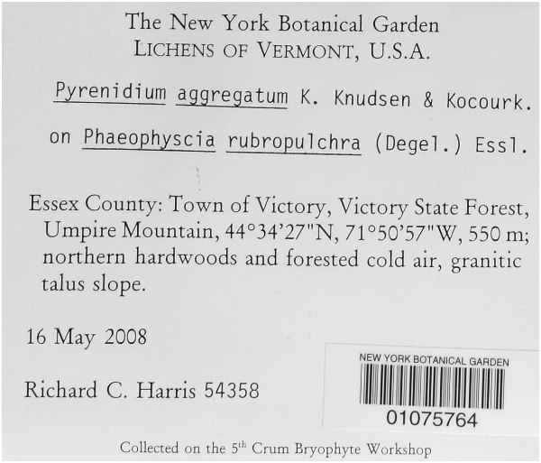
HUB v1
iDigBio HUB V1 Portal --12 / 12 / 12
anticipating real data -- January 2013
Symbiota
Lichens, Bryophytes and Climate Change TCN
VertNet

Slide 7
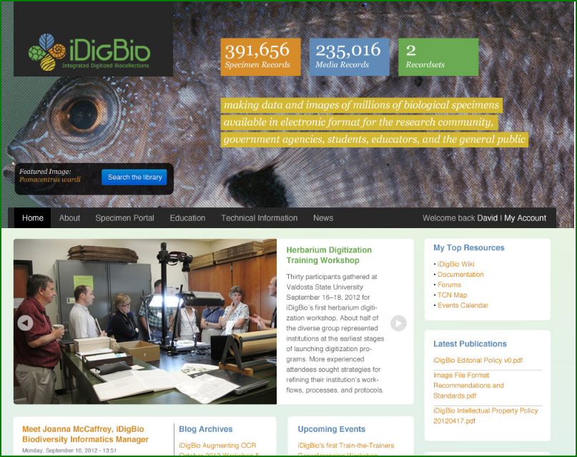
HUB v1
idigibio.org

Slide 8
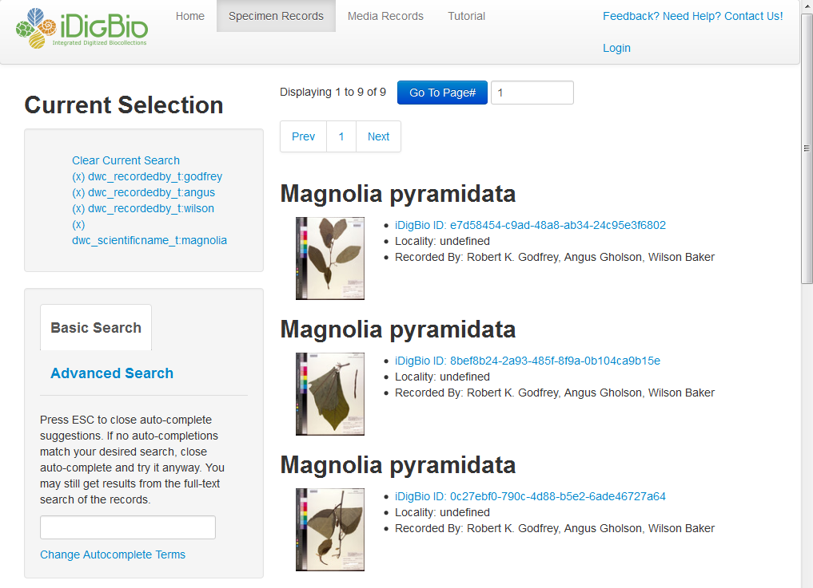
boolean OR

Slide 9
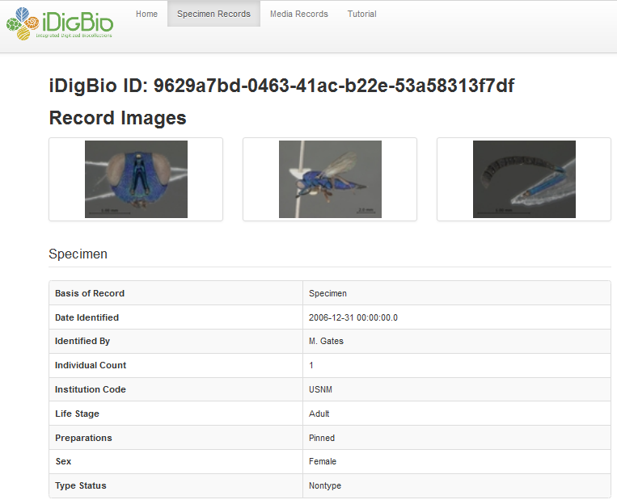

Slide 10
HUB v1
iDigBio API v1 (Releasing 11/9/12)
Adds support for storage of taxon data, people, and organizations
Improved handling of inter-type relationships
Ready to enable write access for a limited set of beta-testers.
iDigBio Portal v1 (Releasing 12/12/12)
Integrated with iDigBio Web authentication.
Slowly expanding interactive features
focus is on backend and process right now
Creation of custom record groups (of people, specimens, or whatever) from searches
Can download groups as CSV, view groups points with coordinates map
Added taxon, people, and organization indexes and searching.
Overall presentation of field names consistent across the portal.
Notes:
services / tools – near future

Slide 11
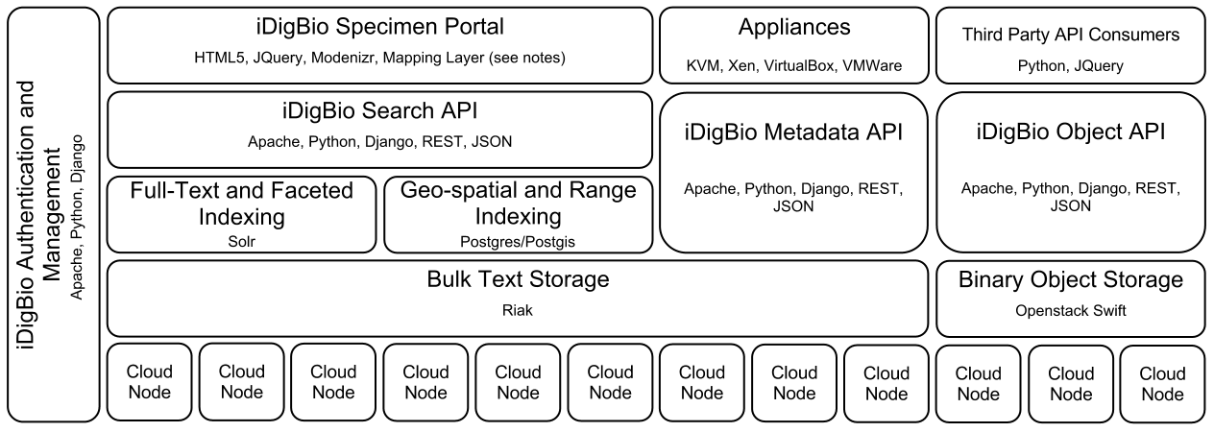
Building the iDigBio Cloud
Cloud-based strategy
Providing useful services/APIs (programmatic and web-based Application
Programming Interface)
Federated scalable object storage and information processing
Digitization-oriented virtual appliances
Reliance on standards, proven solutions and sustainable software
Continuous consultation with stakeholders
Surveys, working groups, workshops, person-to-person
Notes:
iDigBio uses a cloud-based strategy for building its cyberinfrastructure.
The strategy is to build a federated scalable object storage and information processing that can be accessed through programmatic and web-based interfaces; always relying on standards, proven solutions and sustainable software that can be packaged in virtual appliances that facilitate the digitization workflow.
This process is transparent and with continuous consultation with stakeholders through surveys, working groups, etc.
The picture abstracts main components that are being built into the iDigBio cyberinfrastructure, and suffices to say that it is being built having in mind the strategy just described.
----------------------
If the presenter is asked about the details of the figure, it shows:
a) The physical hardware at the bottom layer (“Cloud Nodes”);
b) The storage of both text and binary objects (“Bulk Text Storage” and “Binary Object Storage”) on top of physical nodes;
c) Various types of customized indexing that accelerates searches of data (“Full-text and Faceted Indexing”, “Geo-spatial and Range Indexing)”;
d) The different types of Application Programming Interfaces (APIs) that will be exposed to the public (“Search API”, “Metadata API”, “Object API”). The APIs allow other applications, especially from other stakeholders, to ingest and retrieve the data in iDigBio in a programmatic fashion.
e) The “iDigBio Specimen Portal” provides a web-based user interface that also makes use of the exposed APIs.
f) Different types of “Appliances” and “Third Party Consumers” also interact with the exposed APIs with the purpose of facilitating the digitization process by packaging well existing biodiversity tools.
g) All components will need to be integrated and managed securely (authentication, authorization, access control, auditing).
The names in smaller fonts inside each box (e.g., Apache, Solr) are particular software packages considered for delivering the expected capability.

Slide 12
What Makes iDigBio Unique?
Ingest all contributed data with emphasis on GUIDs, not only a restricted set of selected data elements
Maintain persistent datasets and versioning, allowing new and edited records to be uploaded as needed
Ingest textual specimen records, associated still images, video, audio, and other media
Ingest linked documents and associated literature, including field notes, ledgers, monographs, related specimen collections, etc.
Provide virtual annotation capabilities and track annotations back to the originating collection (provider)
Facilitate sharing and integration of data relevant to biodiversity research
Provide computational services for biodiversity research

Slide 13
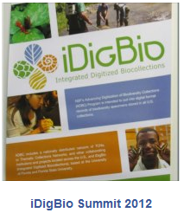
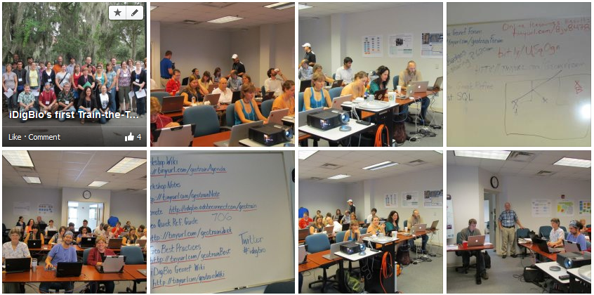
iDigBio on Facebook!
https://www.idigbio.org/content/idigbios-train-trainers-georeferencing-update-ii-out-dark-ages

Slide 14
Get involved! idigibio.org
Join an existing Working Group
Propose a working group
Apply to become a visiting scholar
Apply to attend a workshop
Propose a workshop
Host/Co-host workshops at your next professional meeting
Contribute your questions to our forums
Start a wiki page about your digitization efforts
Share your protocols and workflows
Encourage your students to contribute to our forums
newbies welcome!
Encourage students to apply to our workshops
Encourage students to get involved in a working group
Propose a new TCN
Become a partner (PEN) to a current TCN
Notes:
how to get involved (join working groups, attend workshops, propose needed working groups / workshops, host or co-host workshops at existing meetings, propose tool integration projects, post your questions to our forums – put our staff and working groups collective knowledge to good use)

Slide 15
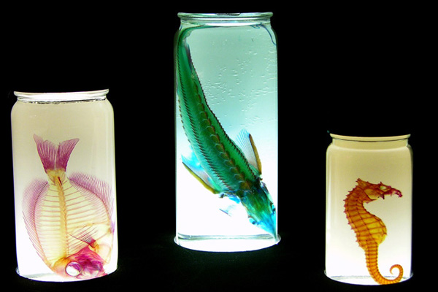
idigibio.org > wiki > working groups
Augmenting Optical Character Recognition (AOCR)
Cyberinfrastructure
Developing Robust Object to Image to Data Workflows
Flat Things
Pinned Things
Things in Jars & large 3-D things
Georeferencing Working Group (GWG)
Minimum Information Standards, Authority Files and Semantics (MISC)
Paleontology
Public Participation in Science

Slide 16
Recent and Ongoing Activities
Assessment of common and effective practices (paper in ZooKeys)
MISC - Minimum information for scientific collections working group
Collaborative georeferencing pilot project at Godfrey Herbarium
DROID - Digitization workflows working groups
Public Participation in Digitization of Biodiversity Specimens workshop
GWG - Georeferencing working group & train-the-trainers workshop
AOCR - OCR/natural language processing working group
Linked data workshop
Series of digitization training workshops
Call for appliances – tool integration
Call for working groups
Cyberinfrastructure working group
Specimen data portal v0 implementation, V1 coming 12/12/12
Server hosting

Slide 17
Upcoming Workshops
Jan 2013 Field Notes (Smithsonian)
Feb 12 iDigBio Augmenting OCR Working Group
2013 iSchools iConference Panel
Feb 13 - 14 iDigBio Augmenting OCR Hackathon
BRIT, Ft Worth TX
March 6-7 Wet Collections Digitization Workshop – KU
April 10-13 Workshop at ASB
April 2013 Entomology Digitization Workshop
Field Museum
Summer 2013 iDigBio GWG Georeferencing Train the Trainers II
June 17-22 Society for the Preservation of Natural History Collections
July 24-Aug 1 Botany 2013
Sept 2013 Paleo Digitization Workshop (place tbd)
idigibio.org > wiki > workshop

Slide 18
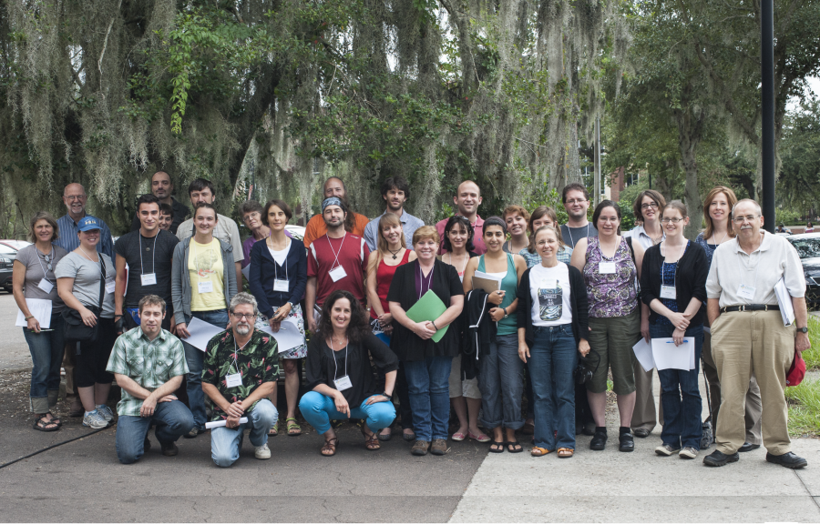
Thanks from
This material is based upon work supported by the National Science Foundation under Cooperative Agreement EF-1115210. Any opinions, findings, and conclusions or recommendations expressed in this material are those of the author(s) and do not necessarily reflect the views of the NSF.

