Slide 1
1B Publishing Primary Biodiversity Data
Alberto González-Talaván¹
Data Sharing, Data Standards, and Demystifying the IPT
Gainesville, FL, USA. 13 January 2015
¹ GBIF Secretariat

Slide 2
Structure of this session
What is biodiversity data?
Rationale for biodiversity data publishing
Data publishing procedure
Data exchange standards
The technical infrastructure
Data publishing software
GBIF Integrated Publishing Toolkit

Slide 3
Structure of this session
What is biodiversity data?
Rationale for biodiversity data publishing
Data publishing procedure
Data exchange standards
The technical infrastructure
Data publishing software
GBIF Integrated Publishing Toolkit

Slide 4

What is biodiversity data?
Digital text or multimedia data record detailing facts about the instance of occurrence of an organism, i.e. on the what, where, when, how and by whom of the occurrence and the recording.
Notes:
Dictionary picture from Asif Akbar, obtained via freeimages.com (http://www.freeimages.com/photo/1150967).

Slide 5
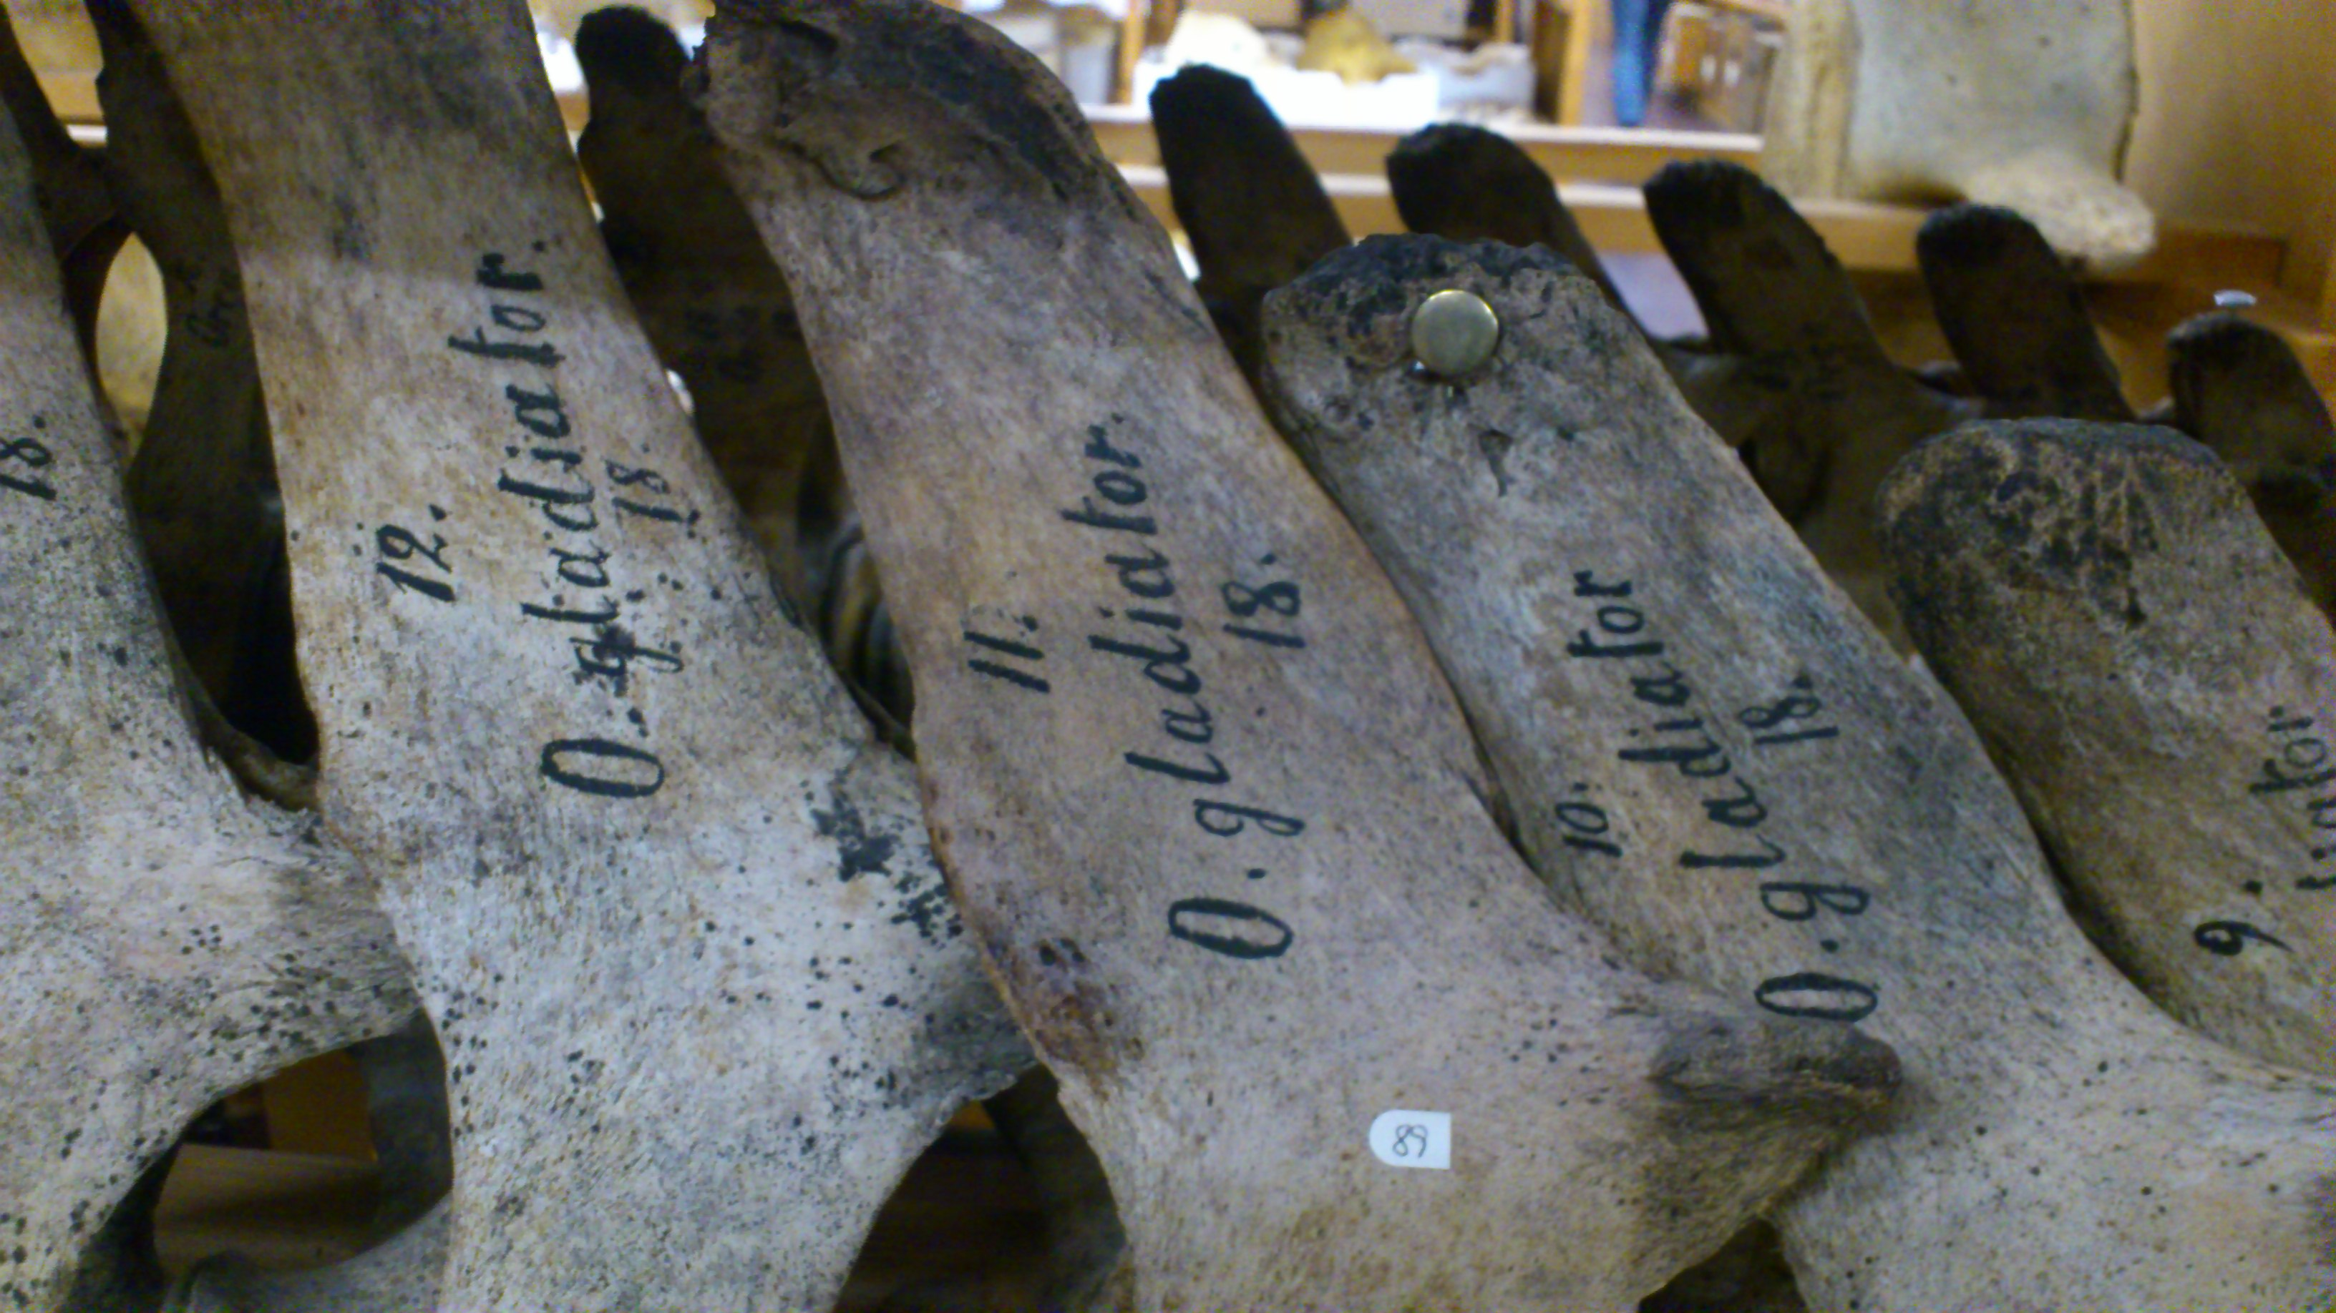
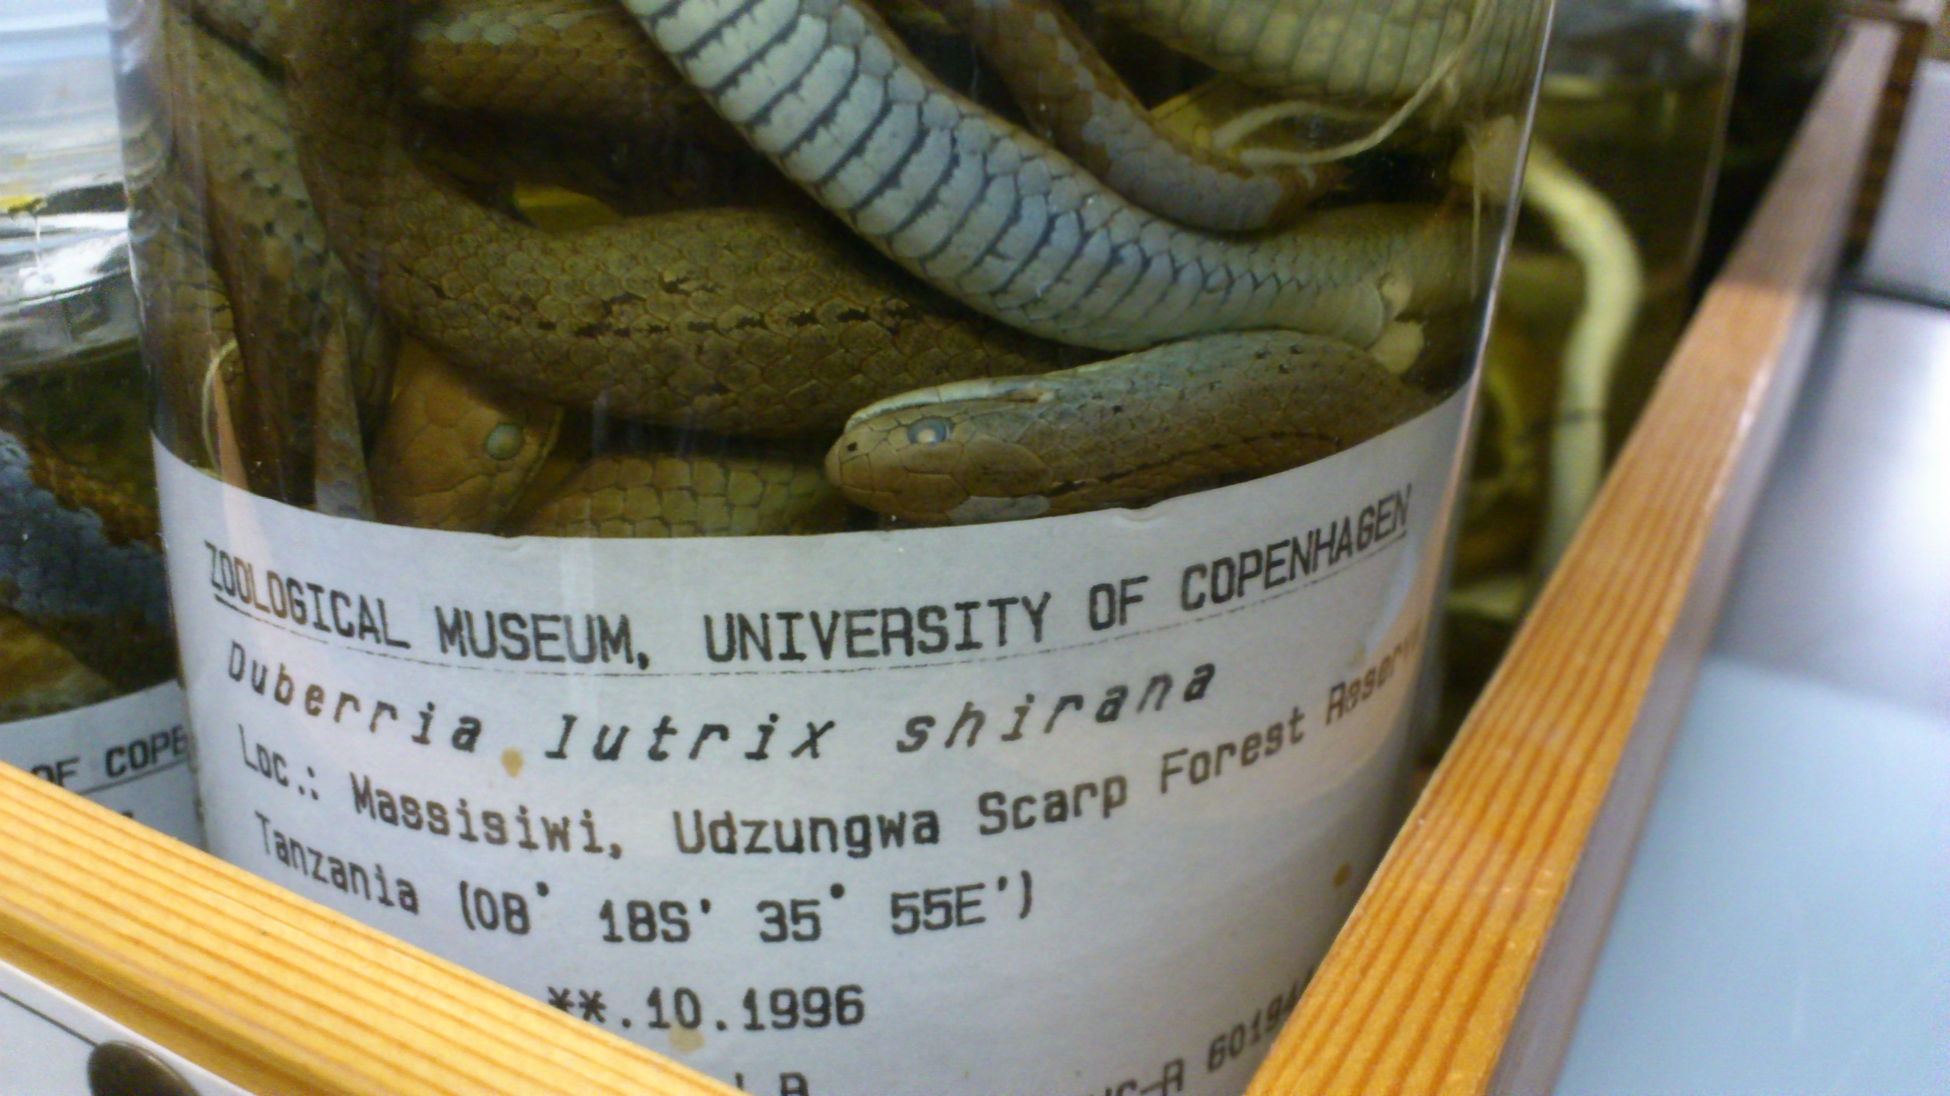
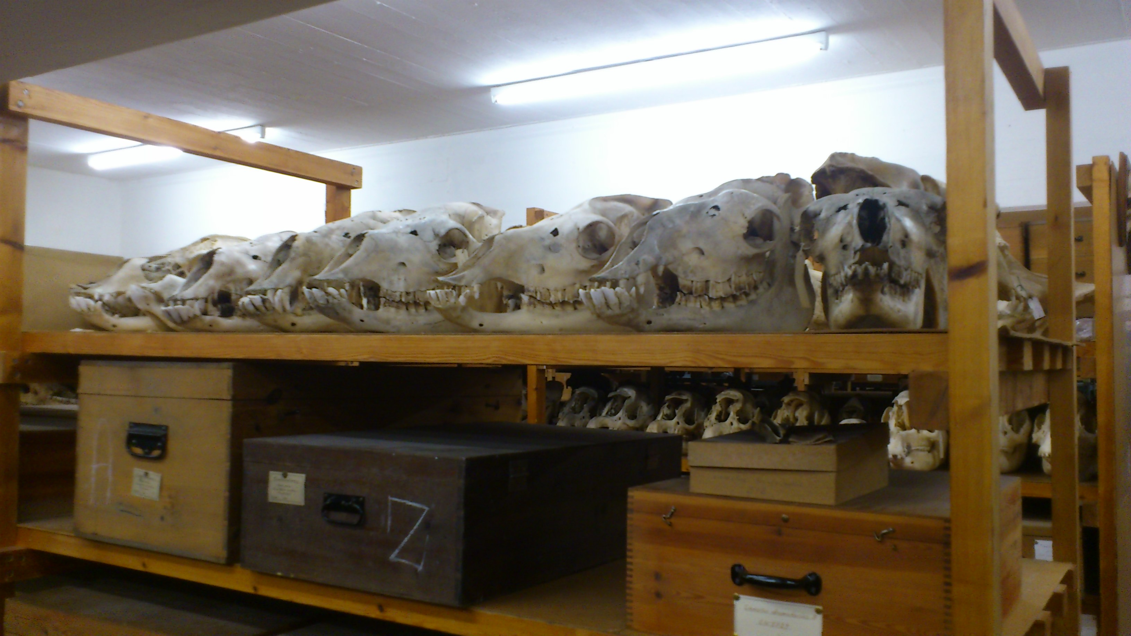
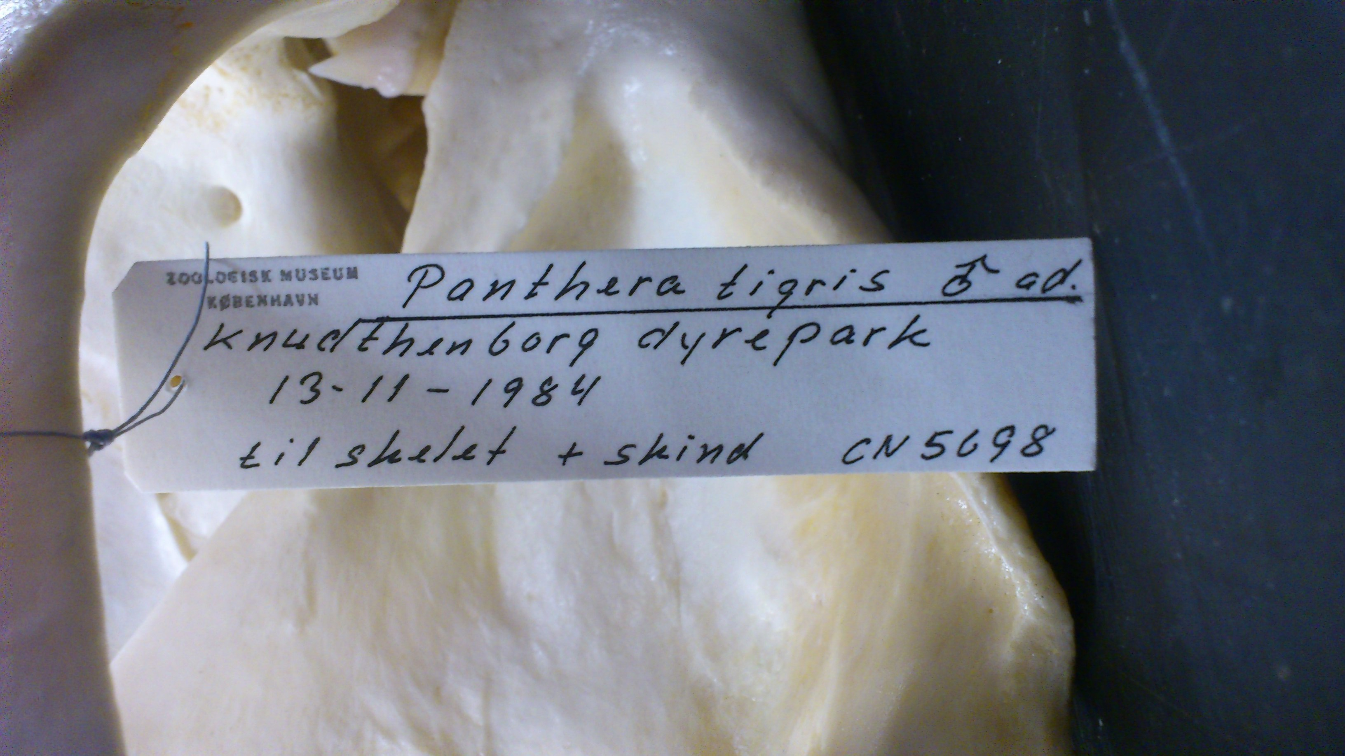
What is biodiversity data?
Specimen labels
Notes:
For many of the participants in this workshop, primary biodiversity data may immediately bring to their minds these kind of images.
Images from the biological collections of the Zoological Museum of the University of Copenhagen (Denmark).

Slide 6

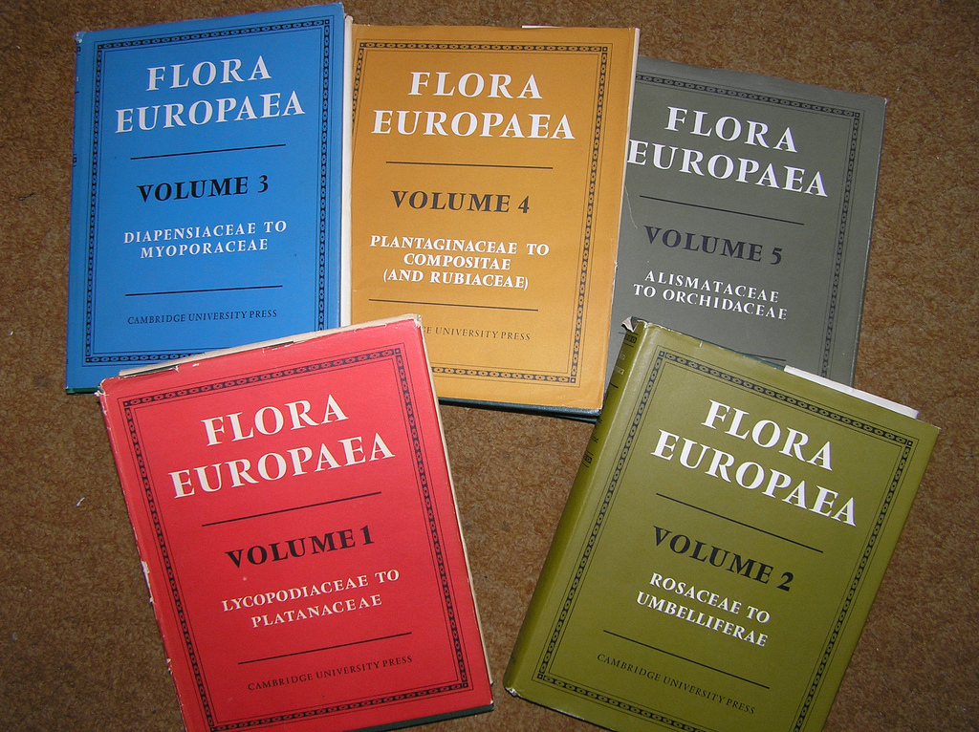


What is biodiversity data?
Journals
Checklists
Assessments
Urban biodiversity

Slide 7
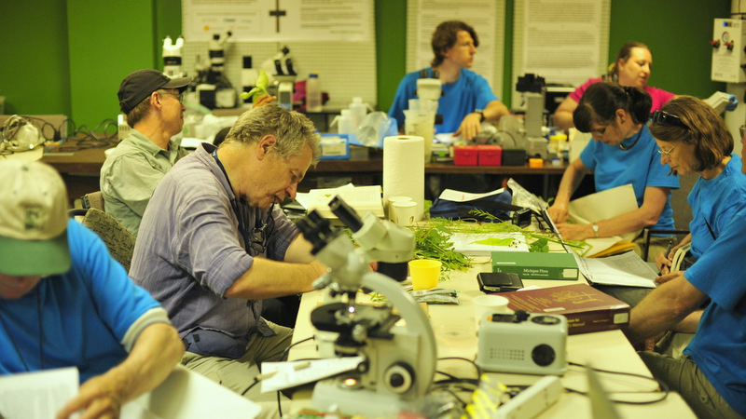
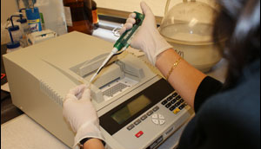
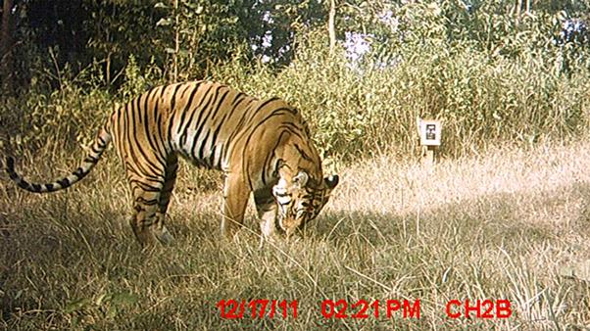
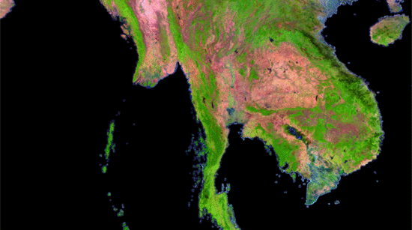
What is biodiversity data?
Citizen science
Genetics
Camera traps
Satellite images

Slide 8
What is biodiversity data?
Specimen labels
Journals
Checklists
Assessments
Urban biodiversity
Citizen science
Genetics
Camera traps
Satellite images
…
Notes:
Different data sources, data types… impose different requirements in the publishing process, standards, software, etc.

Slide 9
Structure of this session
What is biodiversity data?
Rationale for biodiversity data publishing
Data publishing procedure
Data exchange standards
The technical infrastructure
Data publishing software
GBIF Integrated Publishing Toolkit

Slide 10
Structure of this session
What is biodiversity data?
Rationale for biodiversity data publishing
Data publishing procedure
Data exchange standards
The technical infrastructure
Data publishing software
GBIF Integrated Publishing Toolkit

Slide 11



Rationale for Publishing: What is Publishing?
“Publishing” refers to making biodiversity datasets publicly accessible and discoverable, in a standardized form, via an access point, typically a web address (a URL).
IPT
∞

Slide 12
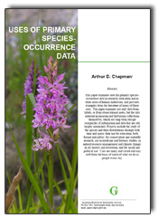
Rationale for Data Publishing: Use
Chapman, A.D., 2005, Uses of Primary Species-Occurrence Data, version 1.0. Report for the Global Biodiversity Information Facility, Copenhagen. 100 pp. ISBN: 87-92020-01-1.
http://www-old.gbif.org/orc/?doc_id=1300

Slide 13
Rationale for Data Publishing: Use
Taxonomy
Biogeographic studies
Species diversity and populations
Life histories and phenologies
Endangered, Migratory and Invasive Species
Impact of Climate Change
Ecology, Evolution and Genetics
Environmental Regionalisation
Conservation Planning
Natural Resource Management
Agriculture, Forestry, Fisheries and Mining
Health and Public Safety
Bioprospecting
Forensics
Border Control and Wildlife Trade
Education and Public Outreach
Ecotourism and Recreational Activities
Society and Politics
Human Infrastructure Planning

Slide 14
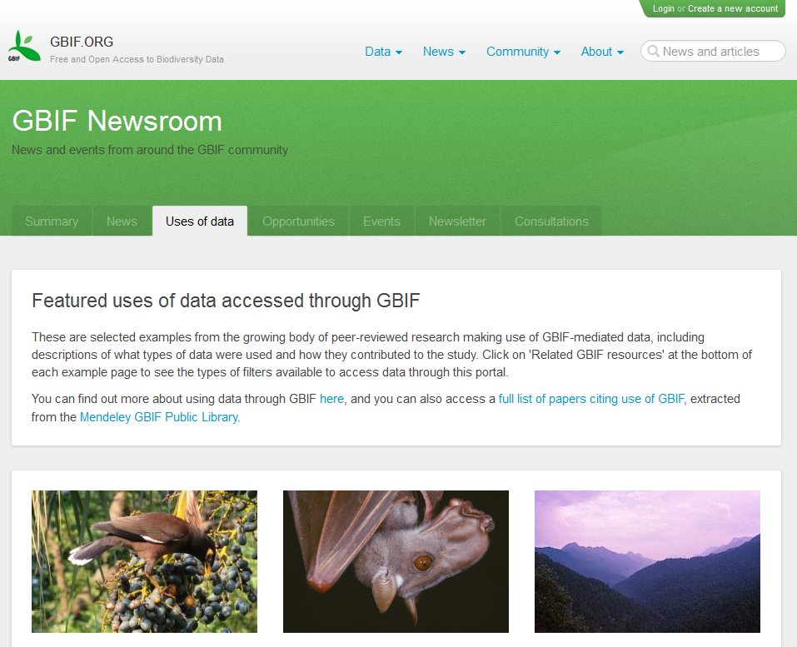
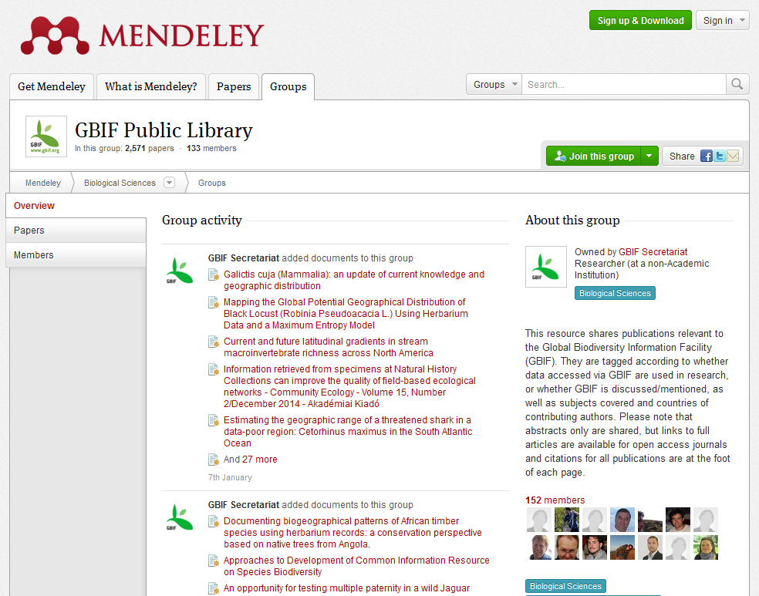

Rationale for Data Publishing: exercise
Featured data section in GBIF.org
http://www.gbif.org/newsroom/uses
GBIF Public Library in Mendeley
http://goo.gl/btrzDa
(requires Mendeley account)
GBIF Science Reviews
http://www.gbif.org/resources/3094
Notes:
Instead of giving an old-style lecture about uses, I suggest an exercise instead: why don’t you use the ‘featured data use’ section of GBIF.org and

Slide 15
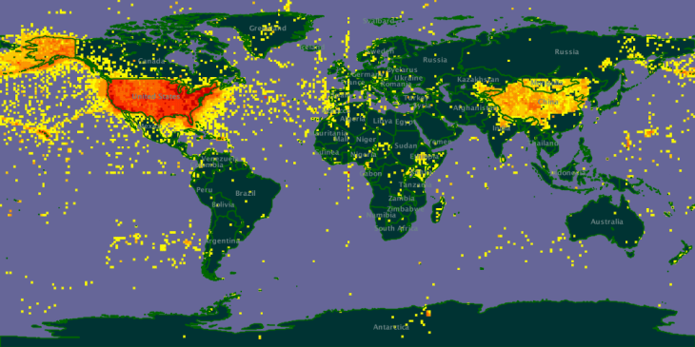
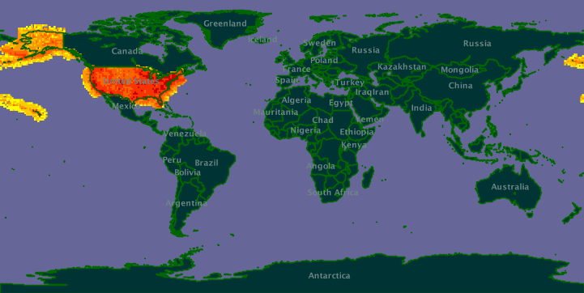
Rationale for Data Publishing: data quality
Verbatim
data
Processed
data
Notes:
In the section talking about the metadata, you will notice that it can be produced as an RDF file. Those files can be submitted to different journals and

Slide 16
Rationale for Data Publishing: citation & usage
“Data citation standards can form the basis for increased incentives, recognition, and rewards for scientific data activities. Unfortunately, such standards and good practices are lacking”
CODATA Data Citation Task Group
“We believe that the lack of incentive similar to the impact factor for scholarly publication remains a major impediment to the provision of free and open access to biodiversity data”
GBIF Data Publishing Framework Task Group
Notes:
In the section talking about the metadata, you will notice that it can be produced as an RDF file. Those files can be submitted to different journals and

Slide 17

Rationale for Data Publishing: benefits
Data Paper
A scholarly publication of searchable metadata document describing a dataset, or a group of datasets
Promote and publicize the existence of the data
Provide scholarly credit to data publishers through citable journal publications
Describe the data in a structured human-readable form
Notes:
In the section talking about the metadata, you will notice that it can be produced as an RDF file. Those files can be submitted to different journals and

Slide 18
Structure of this session
What is biodiversity data?
Rationale for biodiversity data publishing
Data publishing procedure
Data exchange standards
The technical infrastructure
Data publishing software
GBIF Integrated Publishing Toolkit

Slide 19
Structure of this session
What is biodiversity data?
Rationale for biodiversity data publishing
Data publishing procedure
Data exchange standards
The technical infrastructure
Data publishing software
GBIF Integrated Publishing Toolkit

Slide 20
Data Publishing Procedure
Prioritization & planning
Capture
Curation
Export & preparation
Publishing
Notes:
The process of data publishing usually implies many more phases that those we are going to see in this workshop.

Slide 21


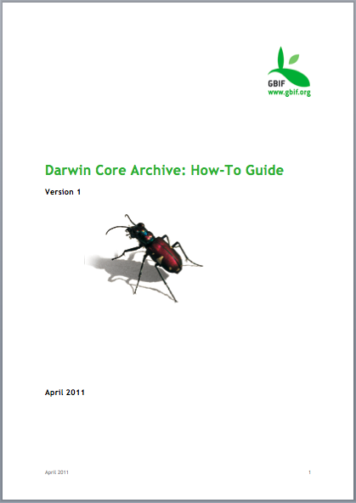
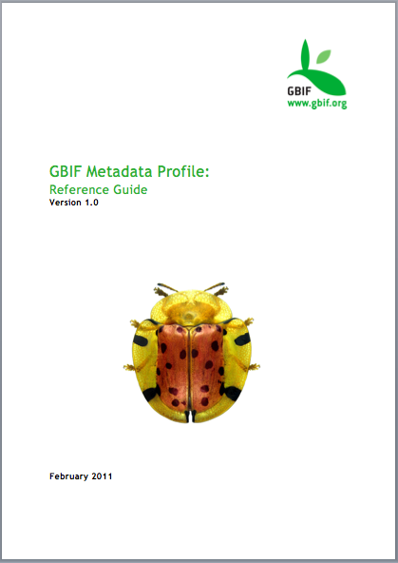


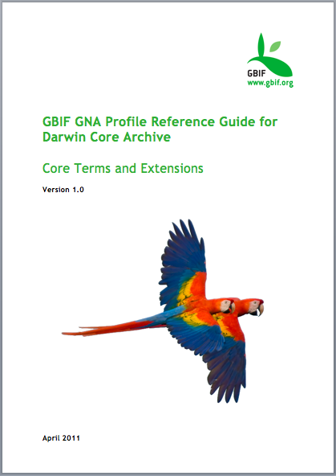
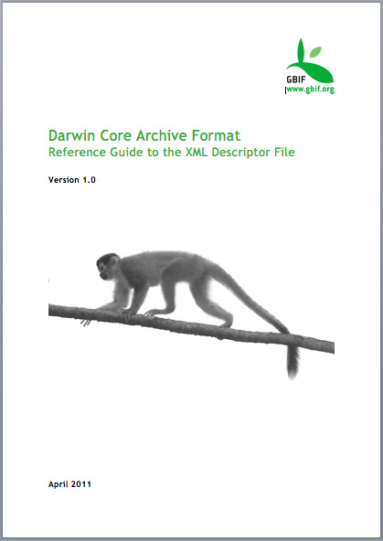
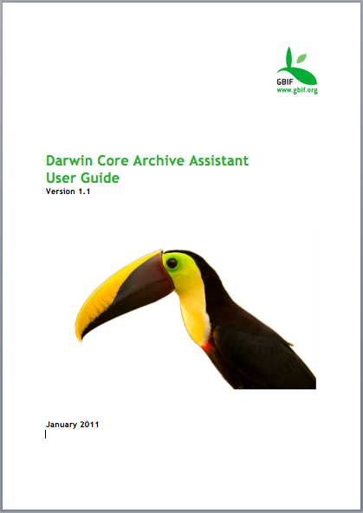
Data Publishing Procedure
Notes:
GBIF has been working on this matter for more than a decade now and there is plenty of documentation in different languages, and also training opportunities for those interested.
Two key resources
Frazier, C.K., Wall, J., and S. Grant. 2008. Initiating a Natural History Collection Digitisation Project, version 1.0. Copenhagen: Global Biodiversity Information Facility. 75 pp. Accessible online at http://www.gbif.org/orc/?doc_id=2176
Towards a Global Strategy and Action Plan for Discovery and Publishing of Natural History Collections Data. Biodiversity Informatics, 7, 2010. ISSN: 1546-9735. Accessible online at https://journals.ku.edu/index.php/jbi/issue/view/323
GBIF. 2010. Best practice guide for ‘Data Discovery and Publishing Strategy and Action Plans’ version 1.0. Authored by Chavan, V. S., Sood, R. K., and A. H. Arino. 2010. Copenhagen: Global Biodiversity Information Facility, 29 pp. ISBN: 87-92020-12-7. Accessible online at http://www.gbif.org/orc/?doc_id=2755
More resources are available in the resources area of GBIF.org: http://www.gbif.org/resources/summary.

Slide 22
Structure of this session
What is biodiversity data?
Rationale for biodiversity data publishing
Data publishing procedure
Data exchange standards
The technical infrastructure
Data publishing software
GBIF Integrated Publishing Toolkit

Slide 23
Structure of this session
What is biodiversity data?
Rationale for biodiversity data publishing
Data publishing procedure
Data exchange standards
The technical infrastructure
Data publishing software
GBIF Integrated Publishing Toolkit

Slide 24

Biodiversity Data Standards
ABCD Access to Biological Collection Data
DwC Darwin Core
DwC-A Darwin Core Archive
NCD Natural Collection Descriptions
AC Audubon Core
… …
www.tdwg.org
Notes:
TDWG is the international body where the standards related to biodiversity data are discussed and agreed. There is a set of procedures that the suggested standards have to go through before they are approved and implemented.

Slide 25
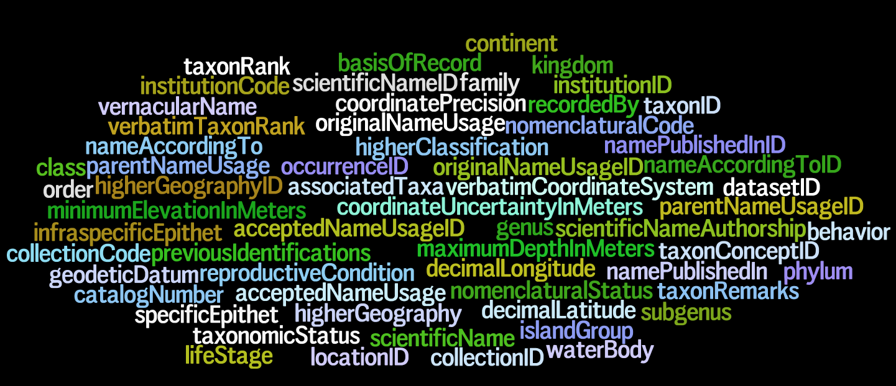
Biodiversity Data Standards: DwC
higherClassification
coordinatePosition
specificEpithet
geodeticDatum
collectionCode
taxonConceptID
taxonRank
collectionCode: The name, acronym, coden, or initialism identifying the collection or data set from which the record was derived. Examples: "Mammals", "Hildebrandt", "eBird".
Notes:
Darwin Core – a glossary of terms
DwC is a defined set of terms with their definitions

Slide 26
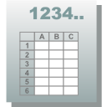
Biodiversity Data Standards: Simple DwC
Flat table
Few restrictions
http://rs.tdwg.org/dwc/terms/simple/index.htm
Notes:
http://rs.tdwg.org/dwc/terms/simple/index.htm

Slide 27

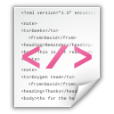
Biodiversity Data Standards: DwC-A
DwC Archive
Ext 5
Ext 1
+
meta.xml
Core
Ext 2
Ext 4
EML.xml
Ext 3
Notes:
http://rs.tdwg.org/dwc/terms/guides/text/index.htm

Slide 28
Biodiversity Data Standards: DwC-A Ex1
DwC Archive
Occurrences
Geographical
+
meta.xml
Occurrence Core
Media
Germoplasm
EML.xml
Determination
Notes:
http://rs.tdwg.org/dwc/terms/guides/text/index.htm

Slide 29
Biodiversity Data Standards: DwC-A Ex2
DwC Archive
Checklist
Types
Description
Distribution
+
meta.xml
Taxon Core
Literature
Vernacular
EML.xml
Occurrences
Notes:
http://rs.tdwg.org/dwc/terms/guides/text/index.htm

Slide 30
Biodiversity Data Standards: DwC-A Ex3
DwC Archive
Samples
Relevé
Occurrences
+
meta.xml
Event Core
EML.xml
Measurement/Fact
Notes:
http://rs.tdwg.org/dwc/terms/guides/text/index.htm

Slide 31
Structure of this session
What is biodiversity data?
Rationale for biodiversity data publishing
Data publishing procedure
Data exchange standards
The technical infrastructure
Data publishing software
GBIF Integrated Publishing Toolkit

Slide 32
Structure of this session
What is biodiversity data?
Rationale for biodiversity data publishing
Data publishing procedure
Data exchange standards
The technical infrastructure
Data publishing software
GBIF Integrated Publishing Toolkit

Slide 33
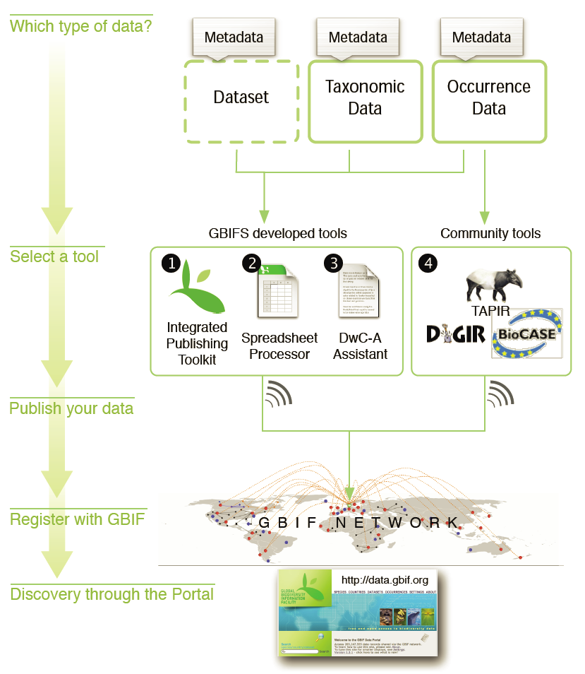
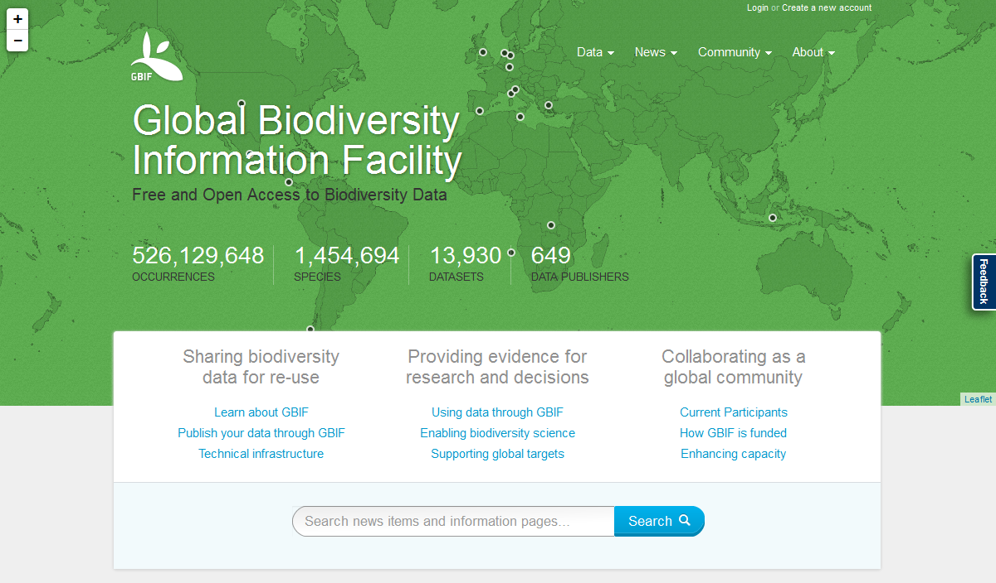
The technical infrastructure: Summary

Slide 34
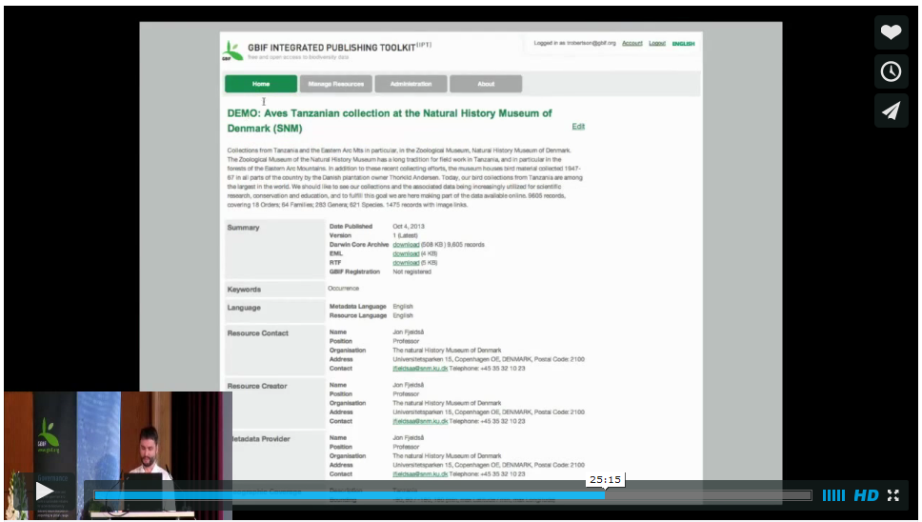
The technical infrastructure: processing
Official launch of the new GBIF.org
http://vimeo.com/77782067 - from 24:15 to 27:00

Slide 35
Structure of this session
What is biodiversity data?
Rationale for biodiversity data publishing
Data publishing procedure
Data exchange standards
The technical infrastructure
Data publishing software
GBIF Integrated Publishing Toolkit

Slide 36
Structure of this session
What is biodiversity data?
Rationale for biodiversity data publishing
Data publishing procedure
Data exchange standards
The technical infrastructure
Data publishing software
GBIF Integrated Publishing Toolkit

Slide 37
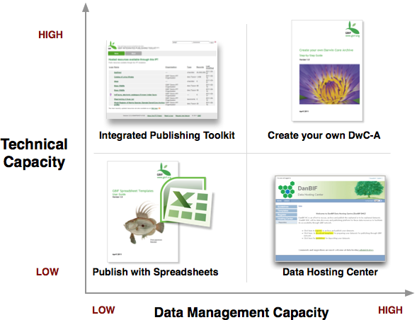

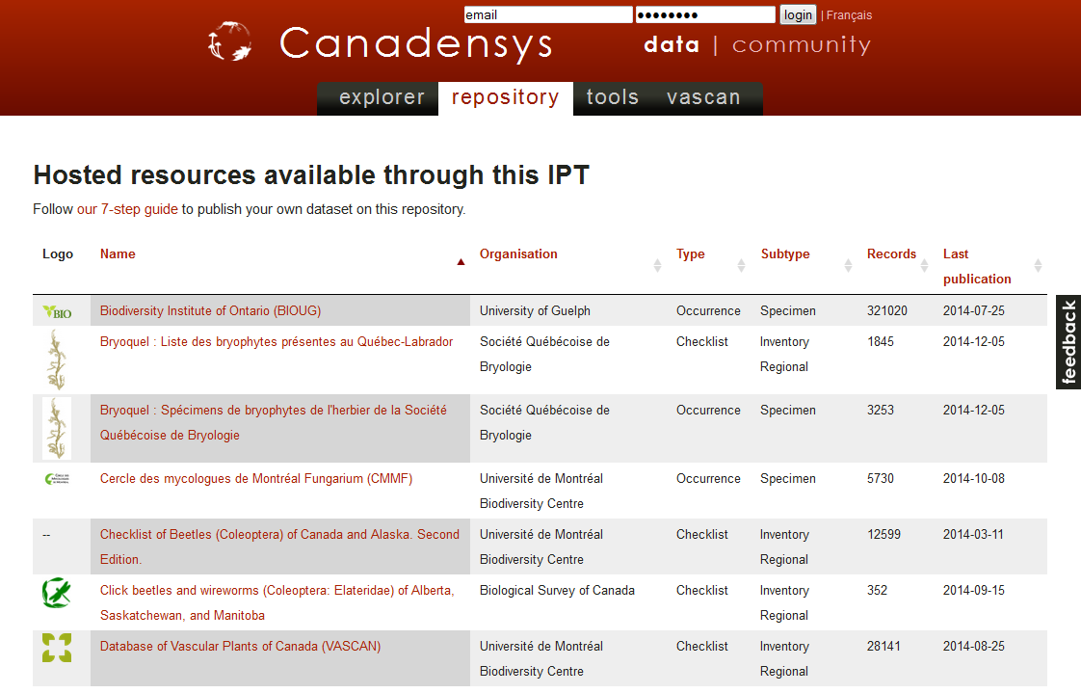
Data publishing software: some options

Slide 38
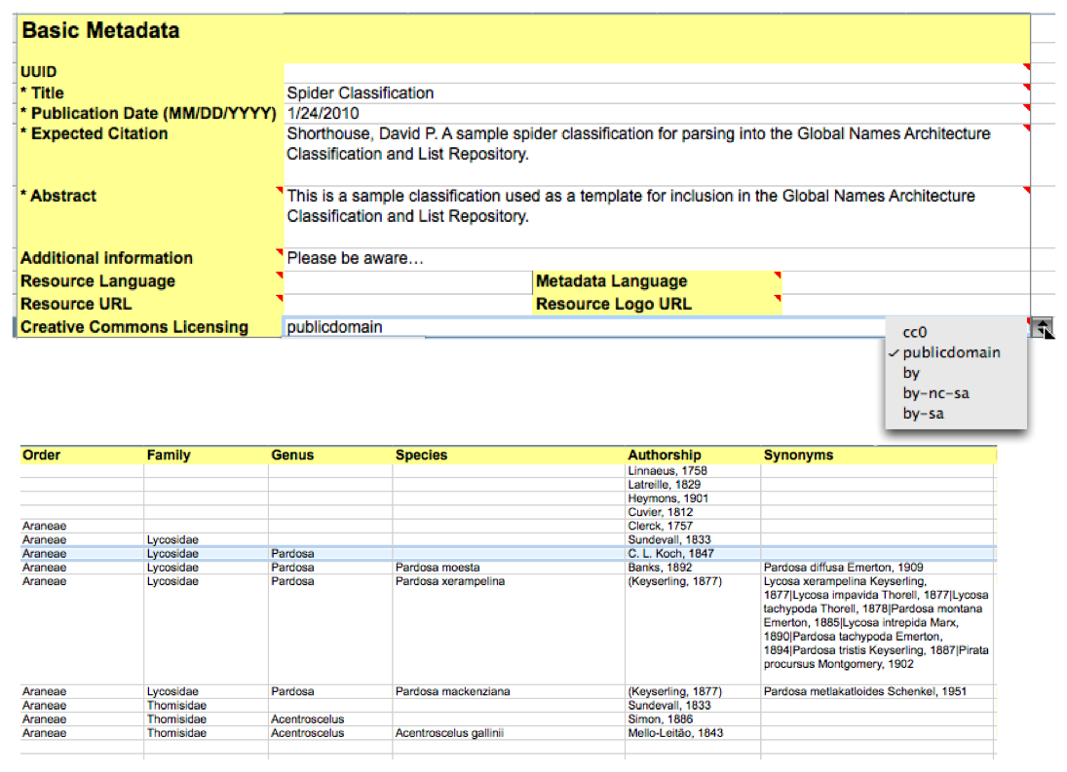
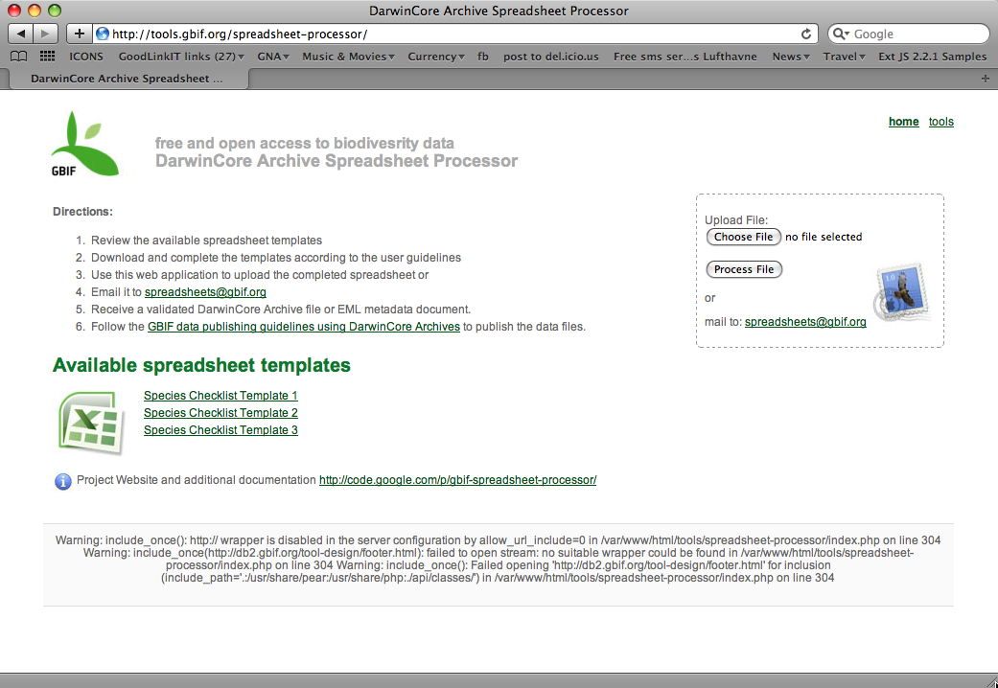
Data publishing software: spreadsheets
Metadata
Primary Biodiversity data
Species Checklists

Slide 39
Structure of this session
What is biodiversity data?
Rationale for biodiversity data publishing
Data publishing procedure
Data exchange standards
The technical infrastructure
Data publishing software
GBIF Integrated Publishing Toolkit

Slide 40
Structure of this session
What is biodiversity data?
Rationale for biodiversity data publishing
Data publishing procedure
Data exchange standards
The technical infrastructure
Data publishing software
GBIF Integrated Publishing Toolkit

Slide 41
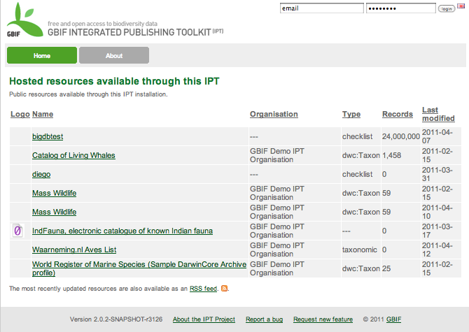
The GBIF Integrated Publishing Toolkit

Slide 42

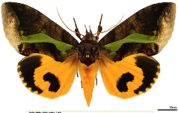







The GBIF Integrated Publishing Toolkit: Vision
A single platform allowing the sharing of
    Primary biodiversity data
    Species name information
    Dataset descriptions (metadata)
The ability to register with GBIF
    Technical contact information
      E.g. Internet URLs
    Physical contact information
      E.g. telephone details
    Institutional affiliations
      Accurate attribution
Connect
    Databases
    Upload text files
      Lower the technical threshold for participation
    Flexibility to accommodate data extensions
    Support efficient and simple transfer of content
    An open source project

Slide 43
Thank you!

